Slide 1

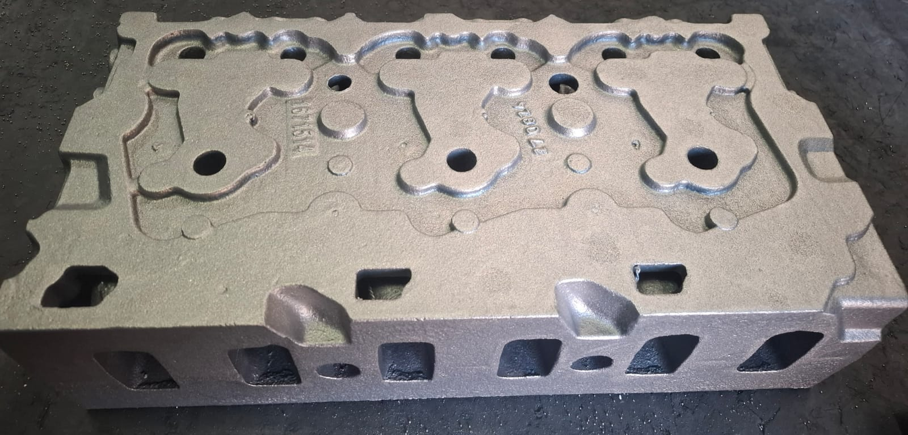
VICAST METALLURGY A.Ş.
Vicast Metallurgy was established in 2023 to produce cylinder heads and engine blocks for heavy vehicles.
Our company, which has continued to grow since then, commissioned the 2nd Factory in 2024. Currently, 31 personnel, 6 white collar and 25 blue collar, work in a total area of ​​3500 m2, 2000 m2 of which is closed, and produces pig and ductile iron castings primarily for the automotive and other sectors.

Slide 2
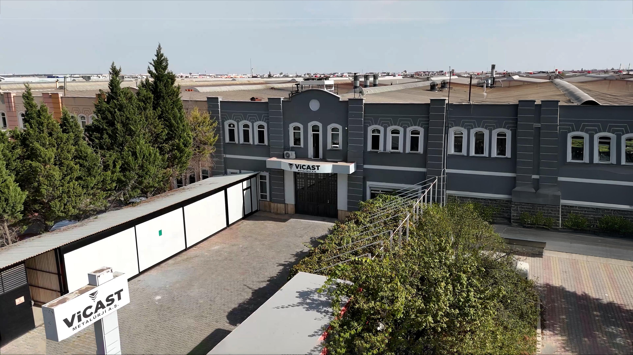

Slide 3
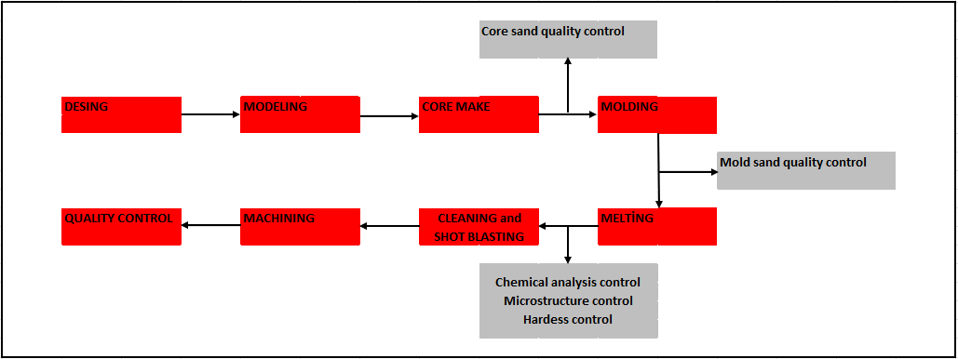
PRODUCT FLOW CHART

Slide 4
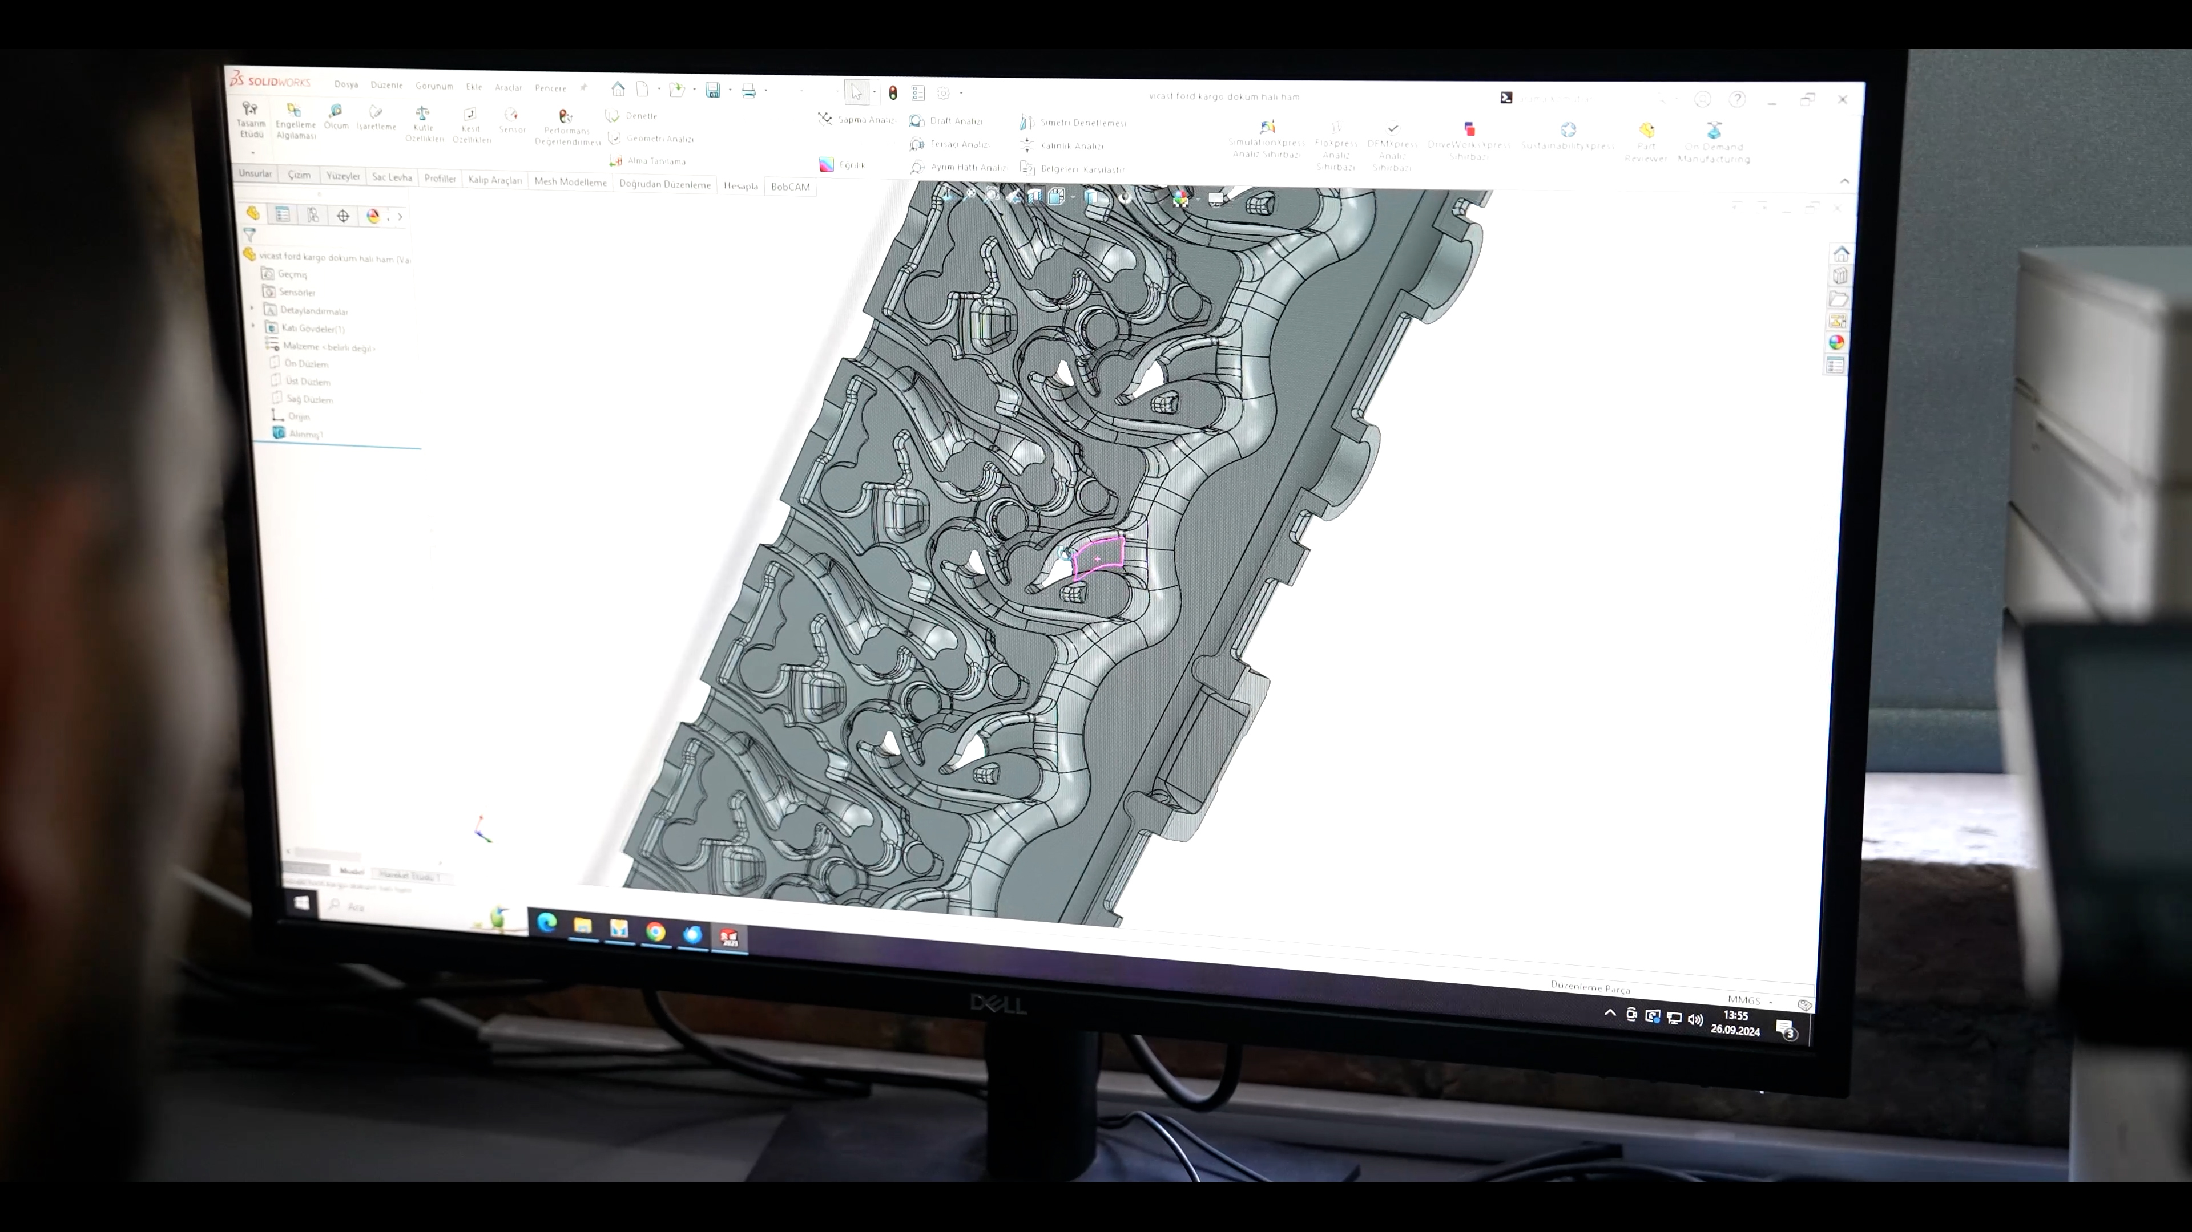
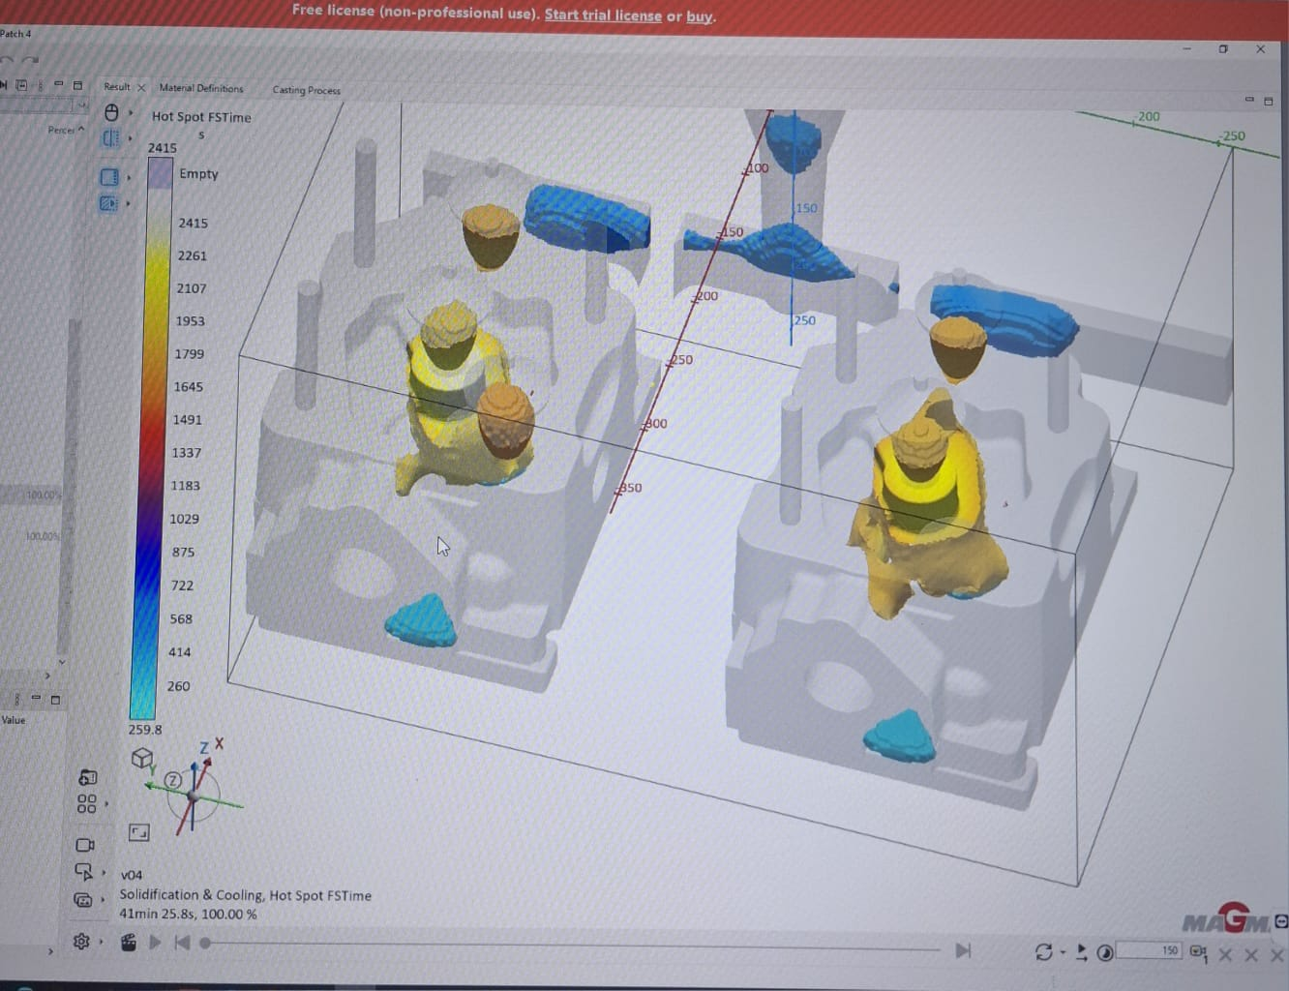
DESING and MODELING
Casting simulation of the products whose design is completed with Solidworks program is done with Magmasoft.
The modeling process is carried out according to these results.

Slide 5
CORE MAKE
In this section there are
7 semi-automatic SHELL core machines.
2 fully automatic SHELL core machines.
2 cold box core machines.
In the core section, cores are made in cold boxes and hot boxes to create the desired internal cavities within the part and are made ready for casting.

Slide 6
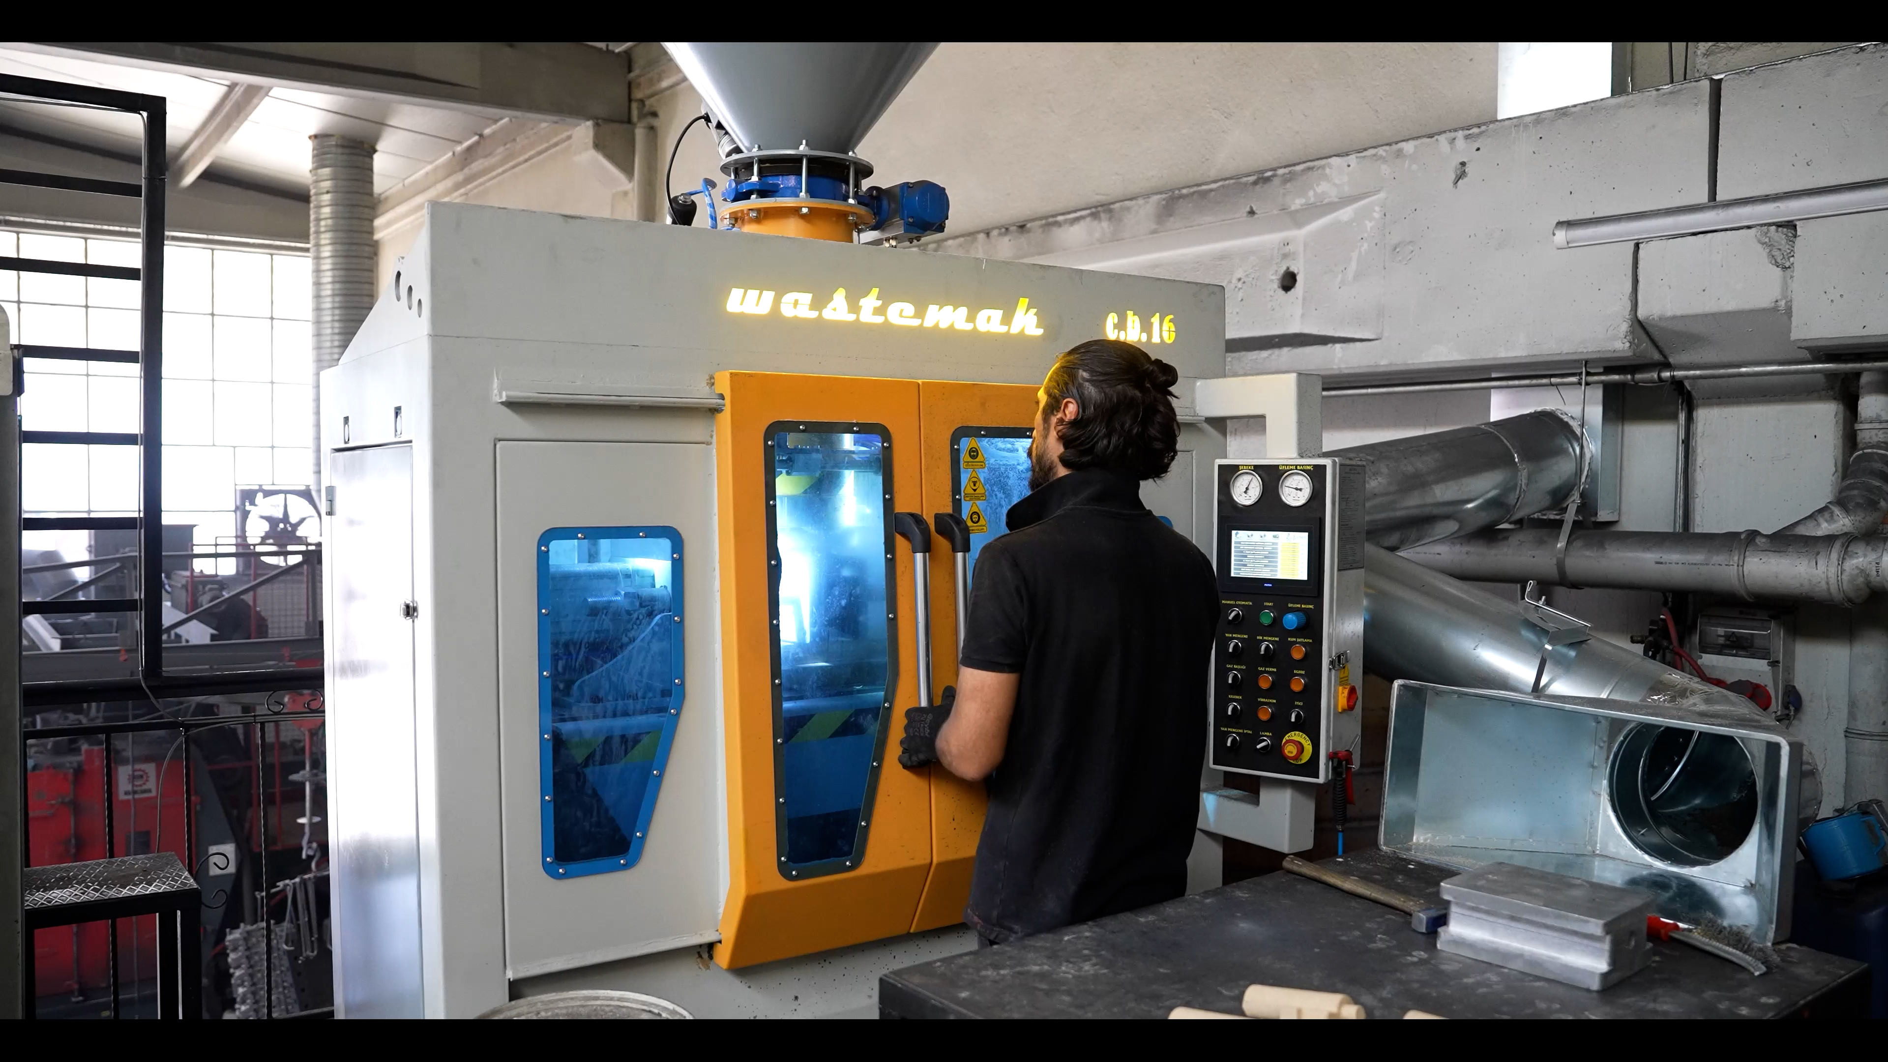
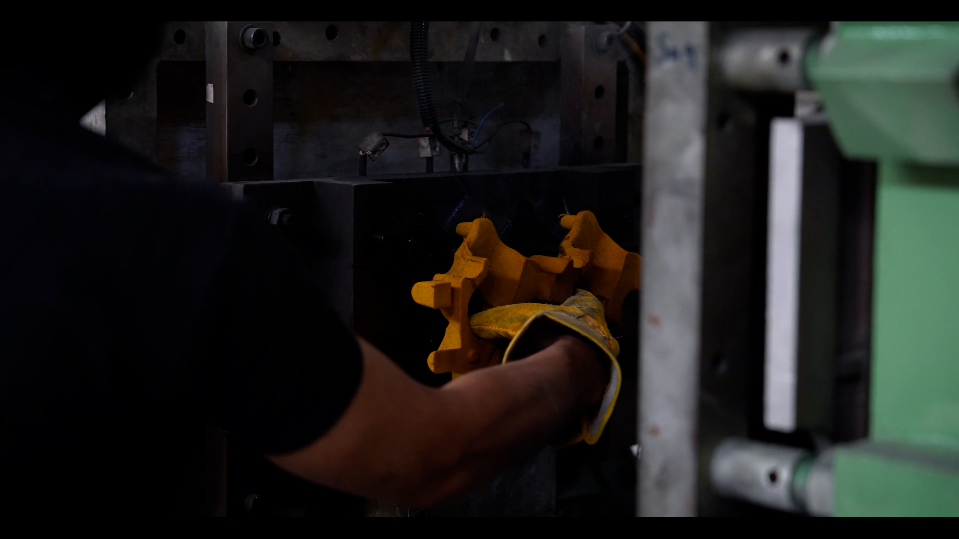
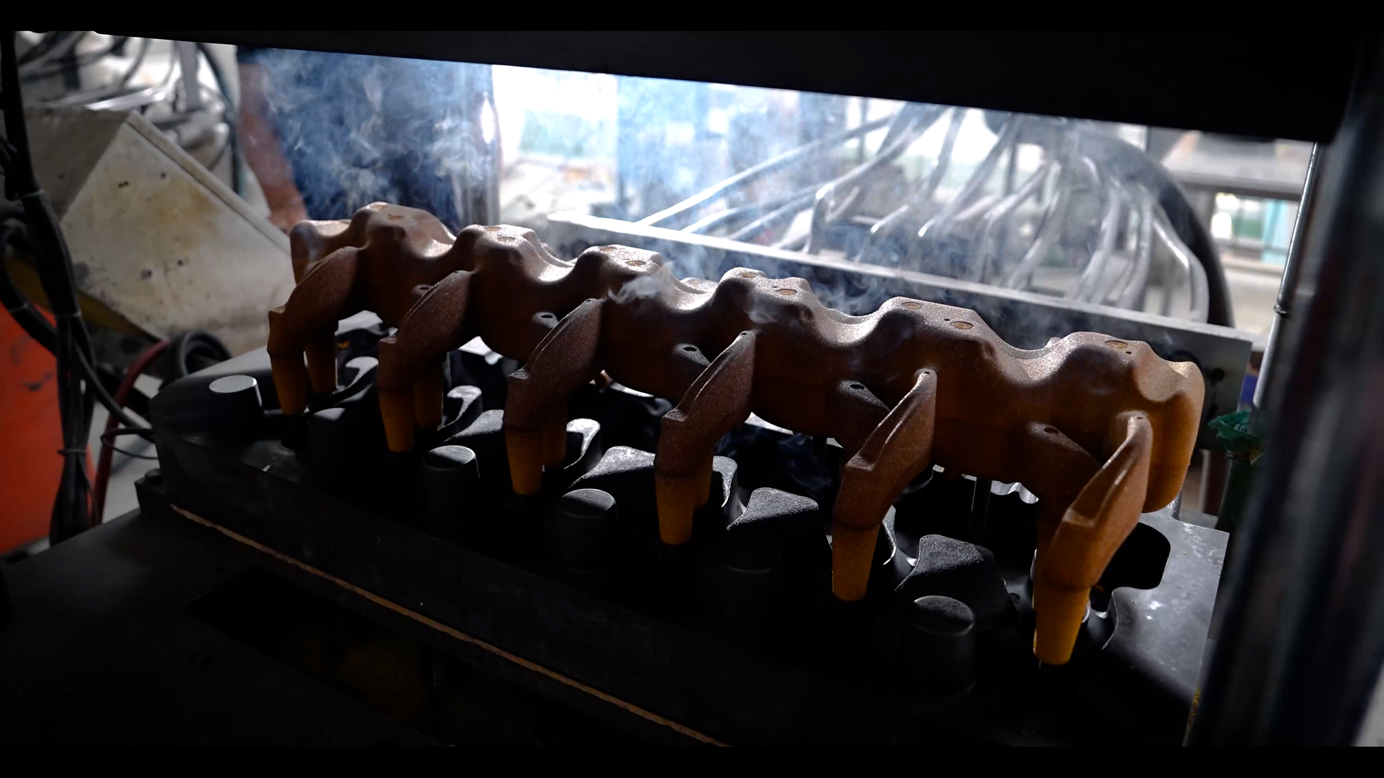

Slide 7
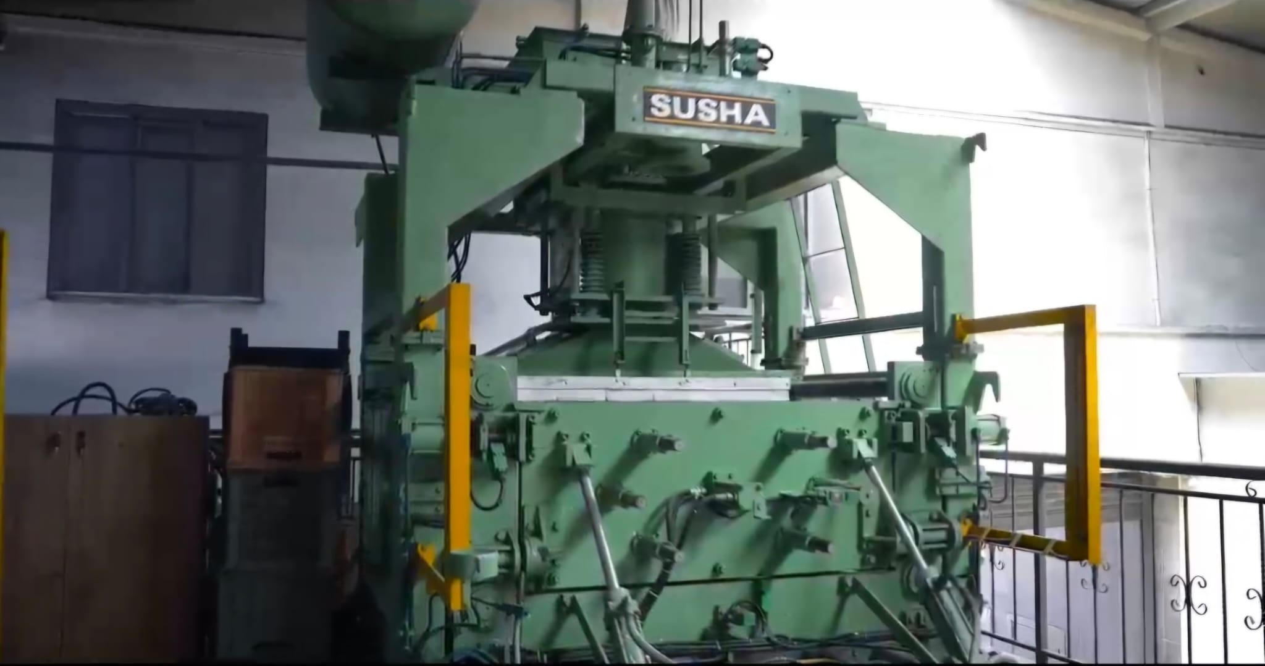
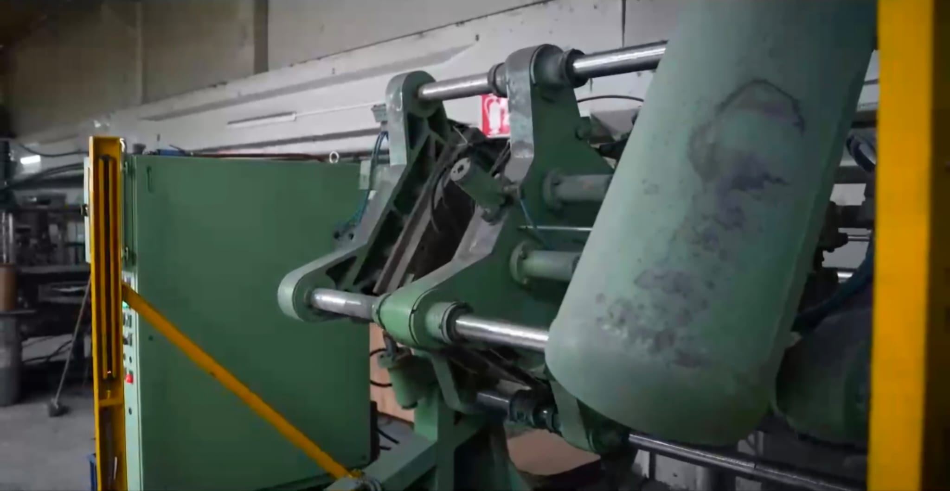
Fully automatic shell core machines

Slide 8
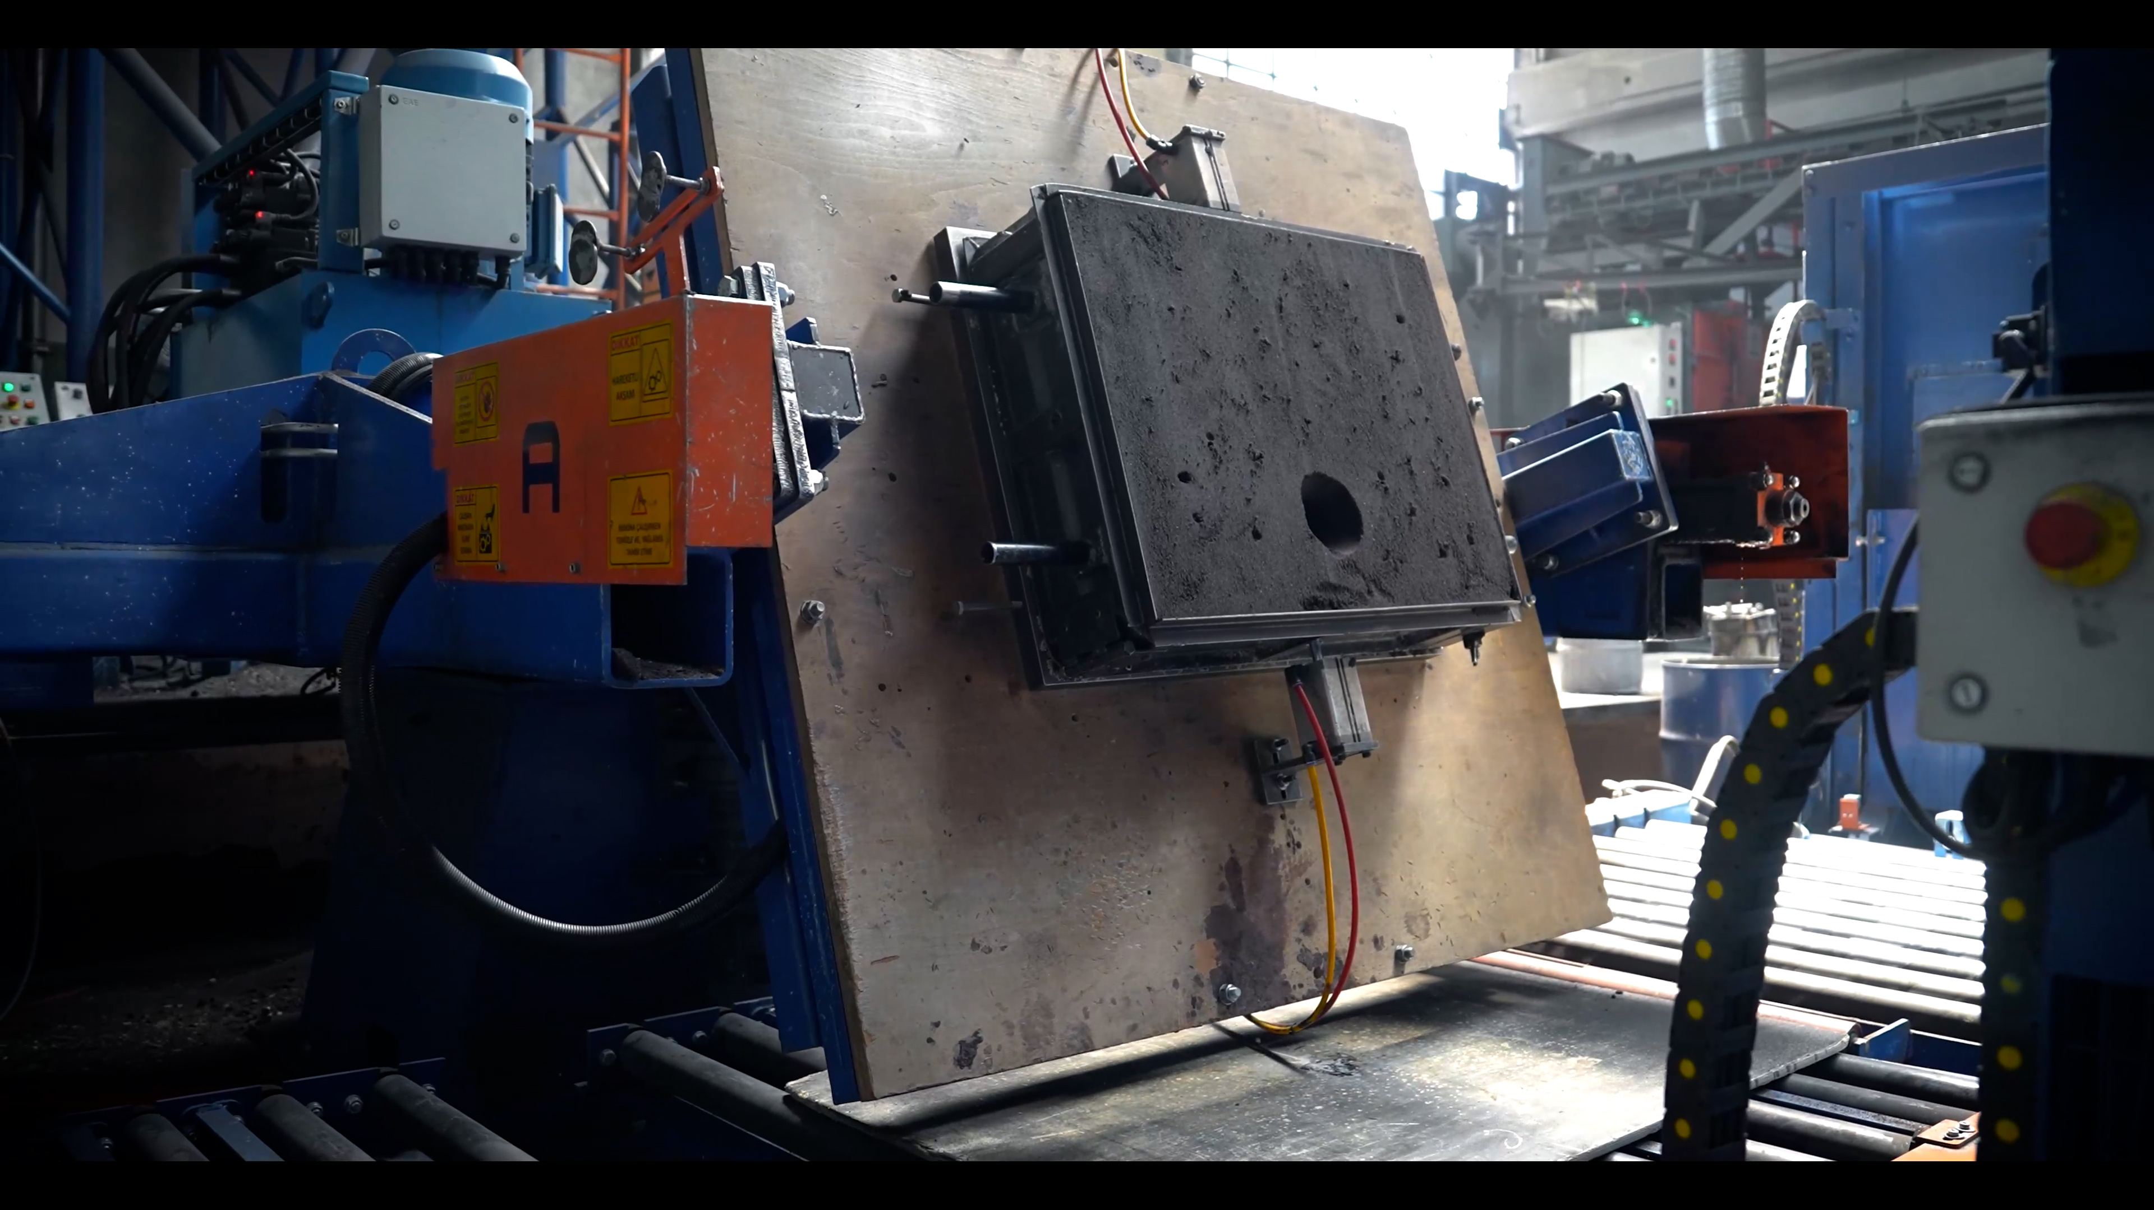
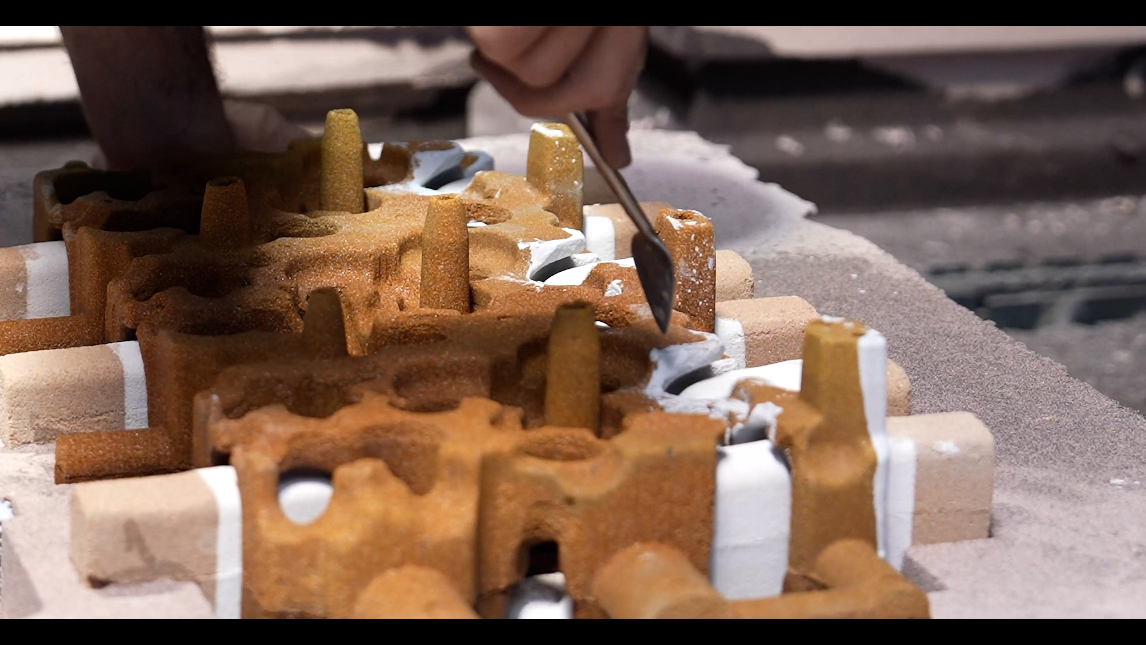
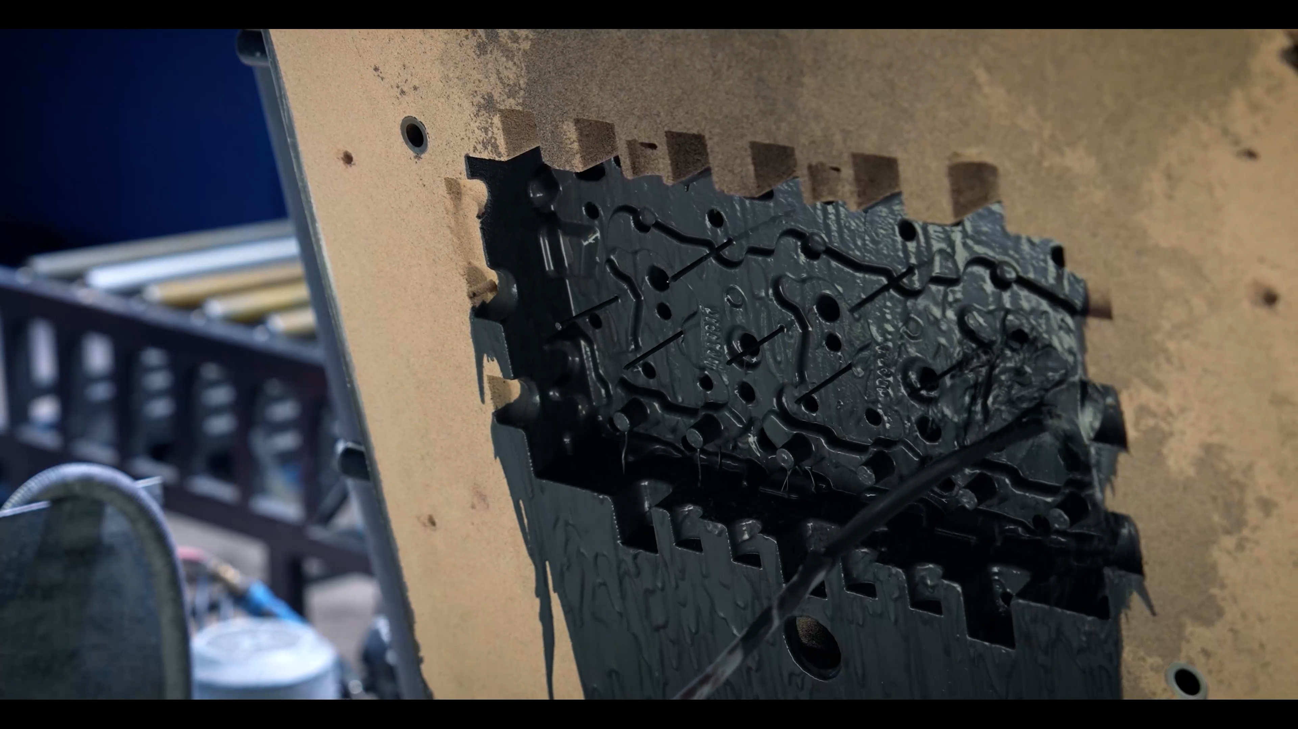
MOLDING
Alphaset resin molding is done in the foundry.
With the strength values ​​offered by Alphaset resin molds, we can produce from 0.1 kilograms to 1000 kilograms.
Our company has a fully automatic Flip molding molding line with a capacity of 12 molds/hour.

Slide 9
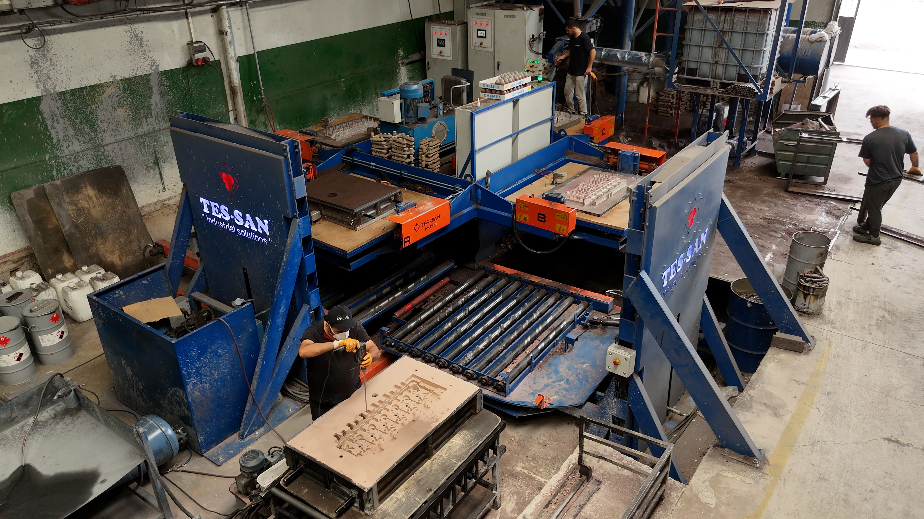
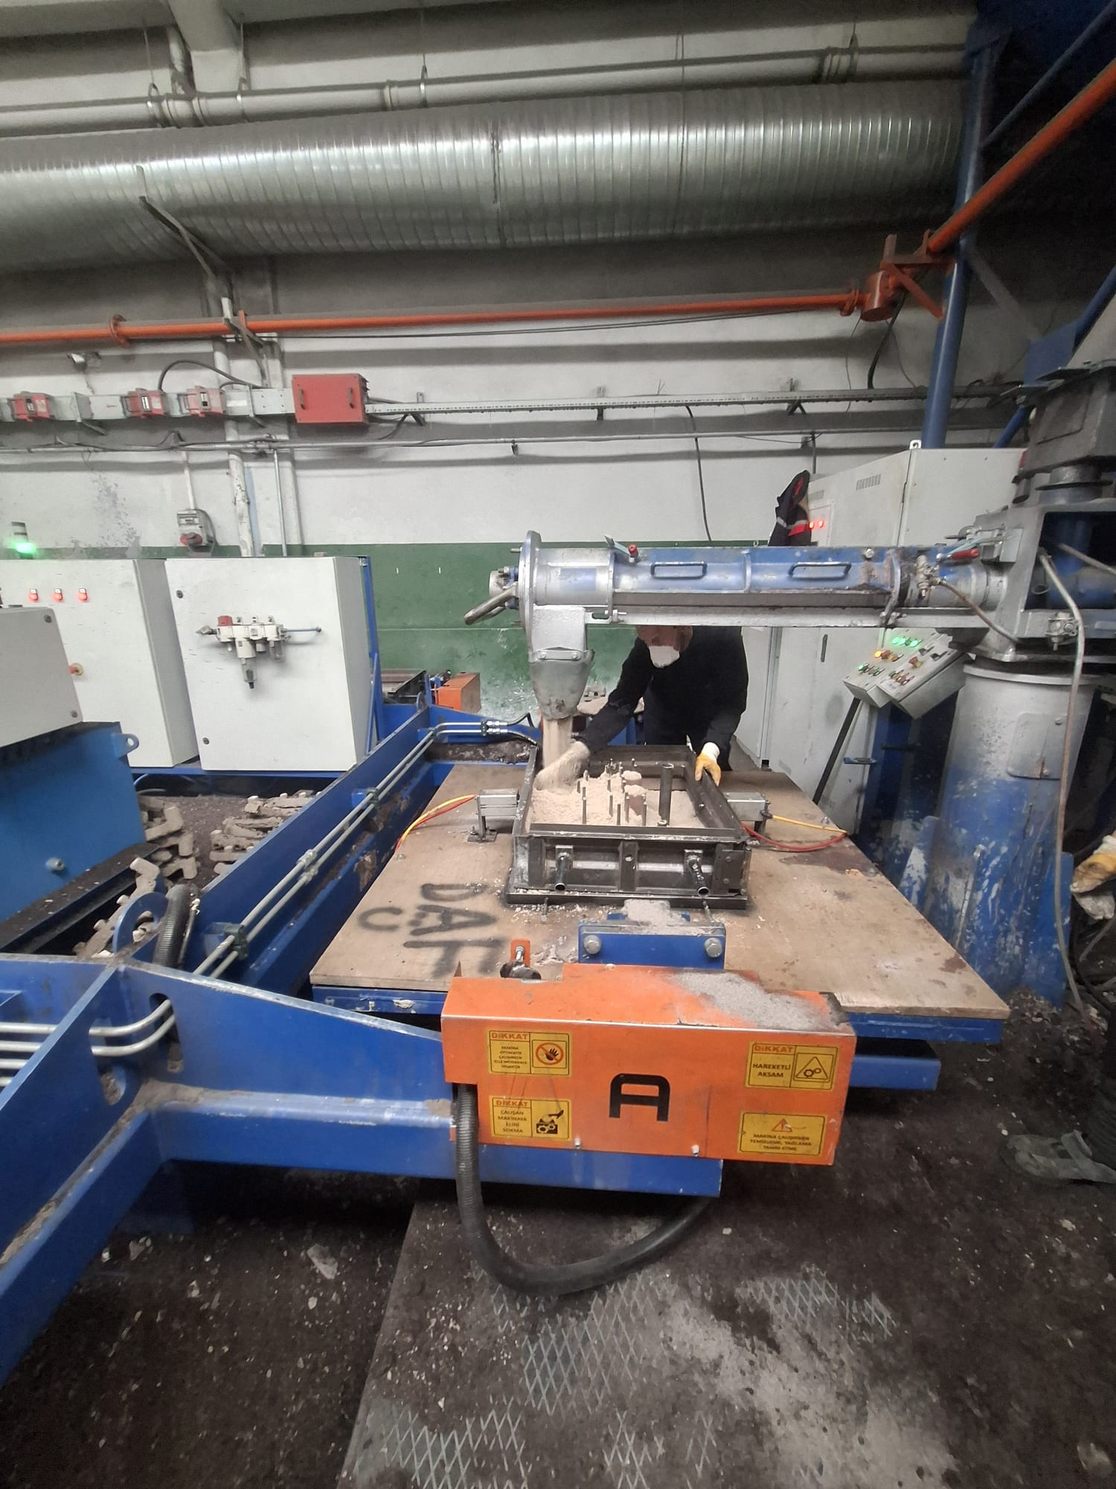
In our flip mold line, 4 different models can be produced simultaneously.
Continuous sand mixer with 6 tons/hour capacity

Slide 10
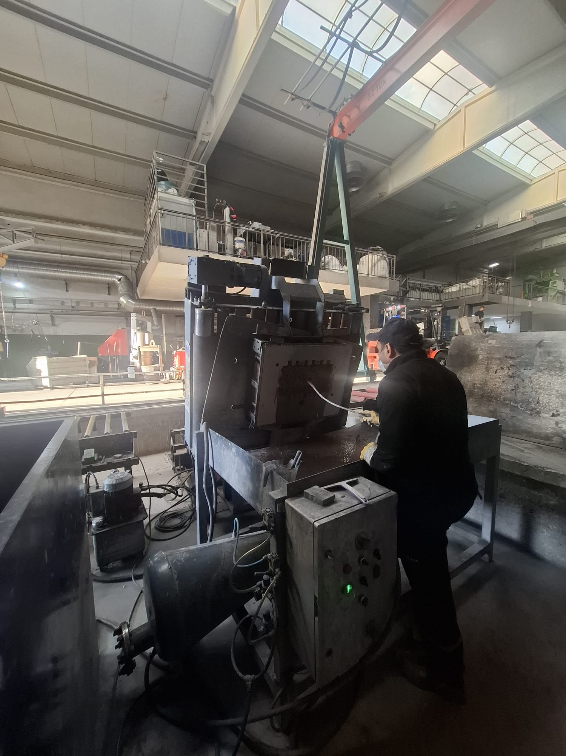
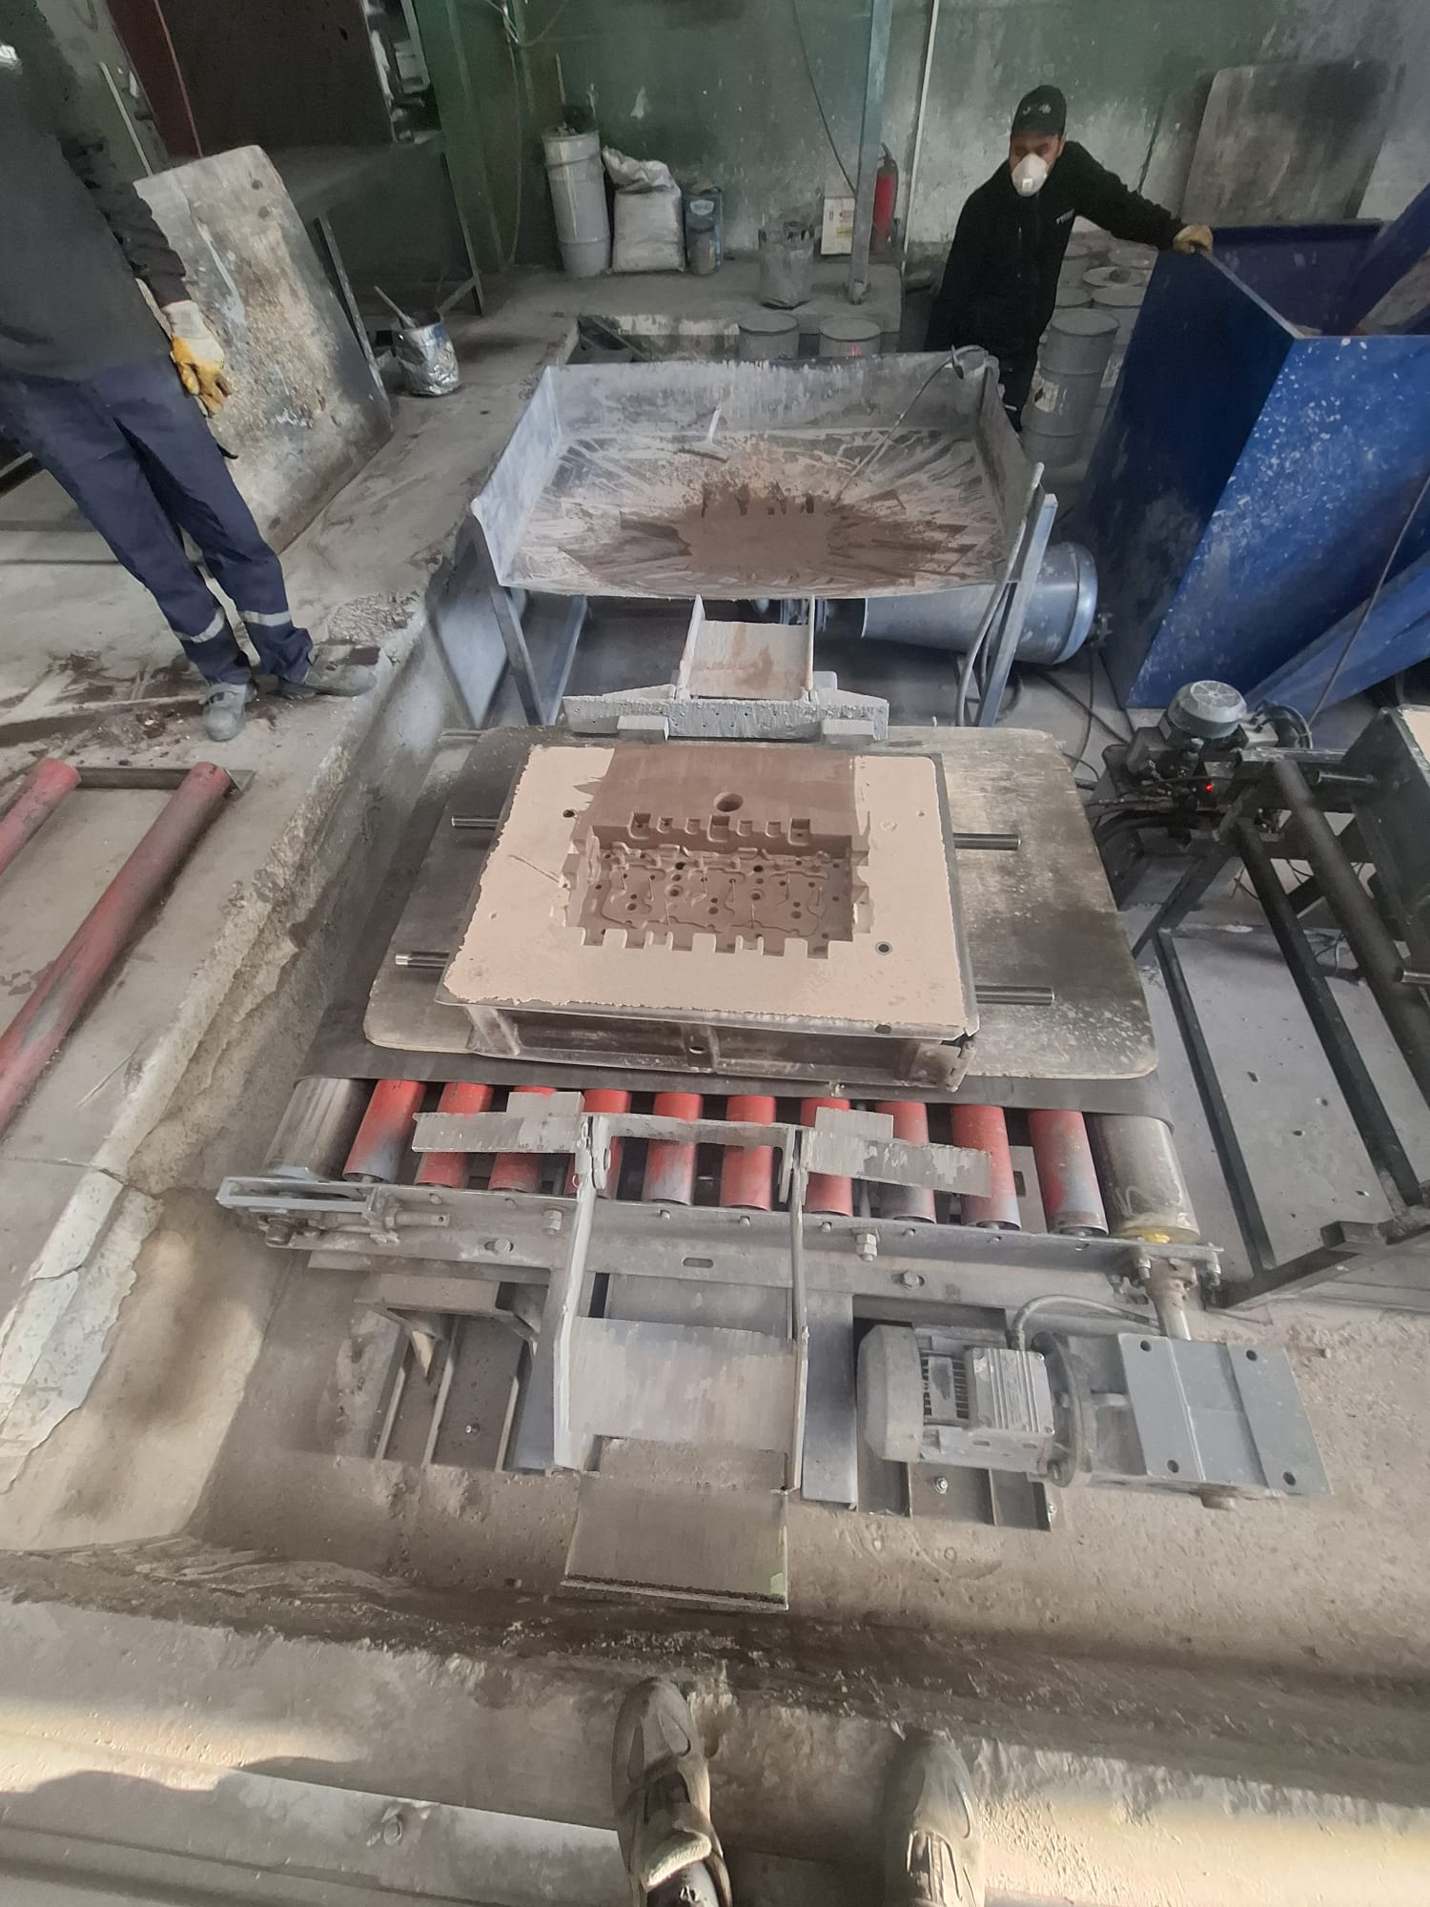
Semi-automatic mold painting station

Slide 11
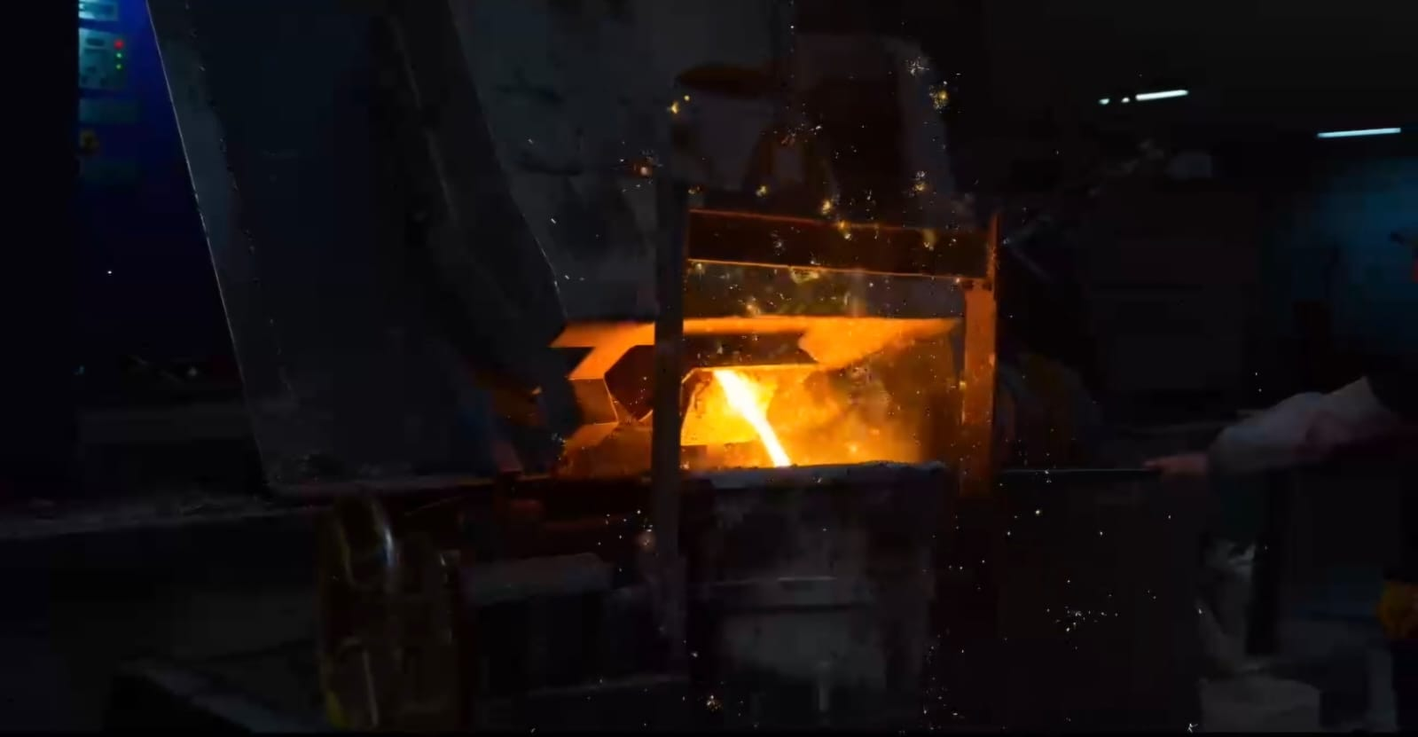
MELTING and CASTING
We can produce Gray Cast Iron and Spheroidal Graphite Cast Iron in the desired quality with our 500-kilogram induction furnaces within the company.

Slide 12
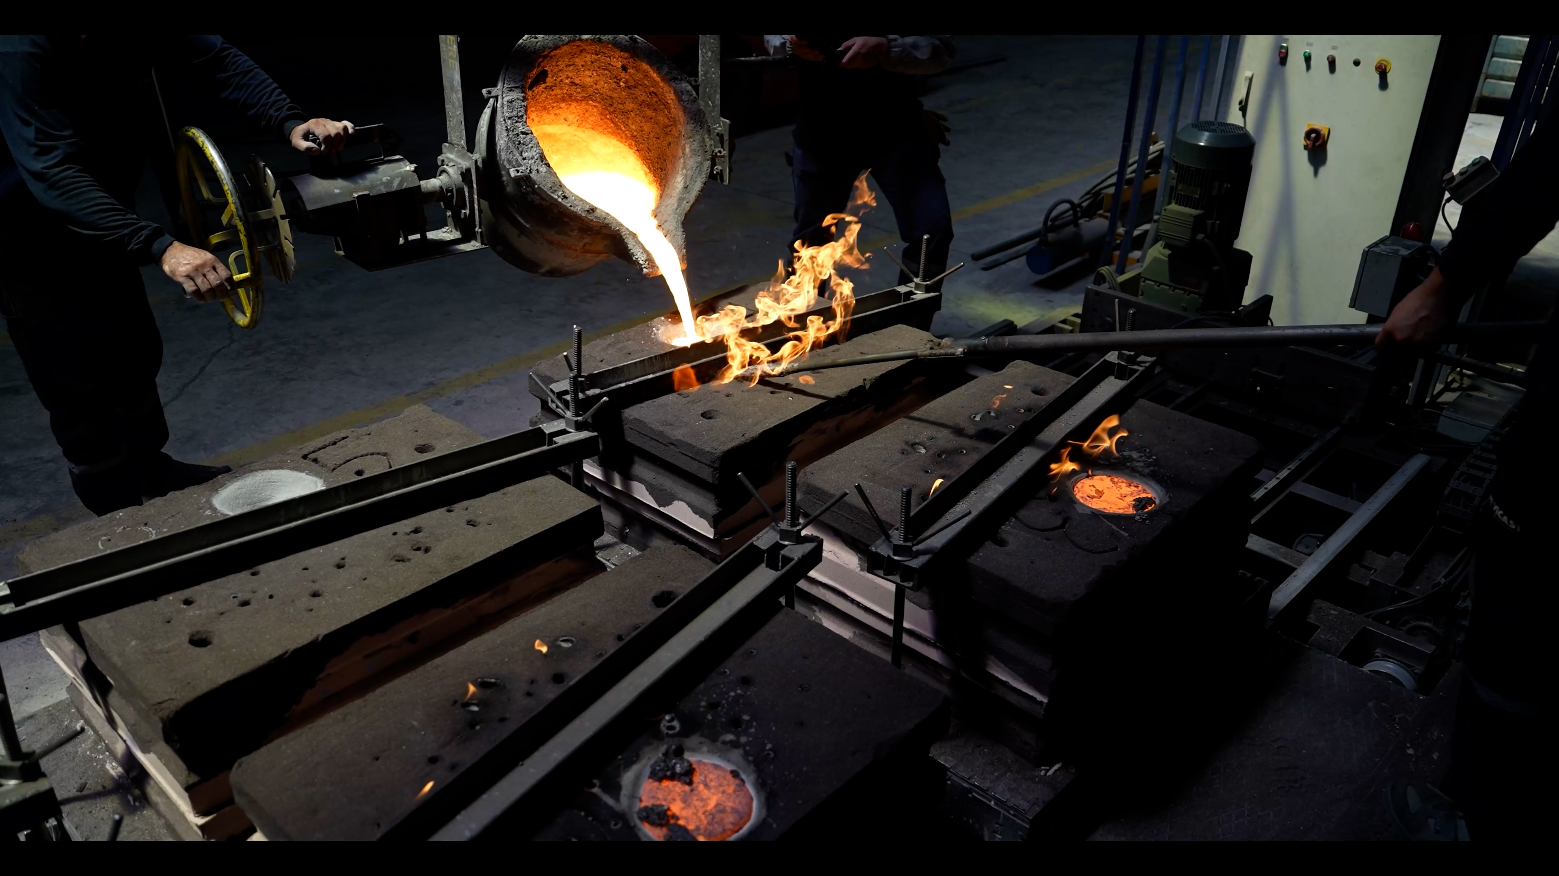
In order to achieve sustainable quality, we ensure traceability by creating records by performing liquid metal control with spectral and thermal analysis by our expert engineers.

Slide 13
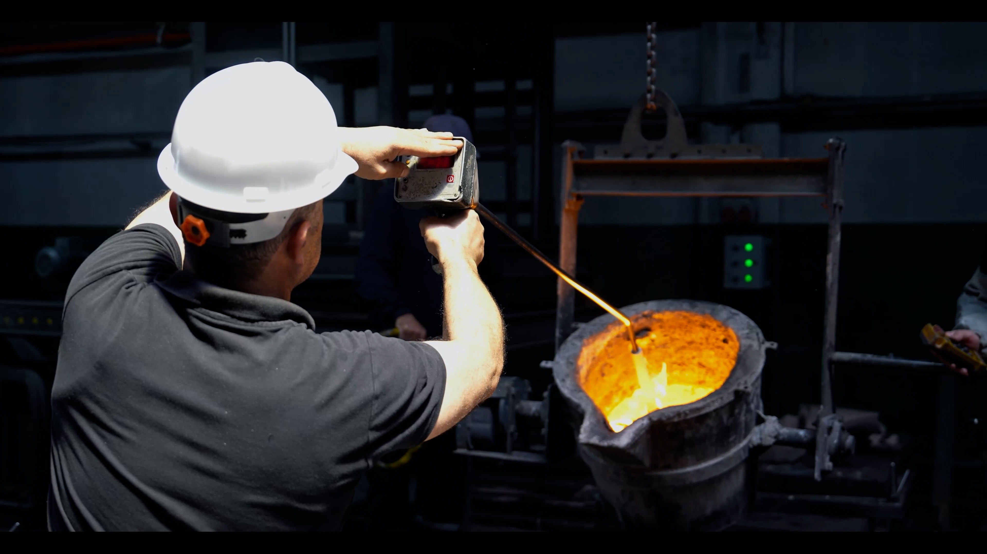
Casting is carried out by controlling the temperature before casting and the time during casting in the prepared liquid metal.

Slide 14
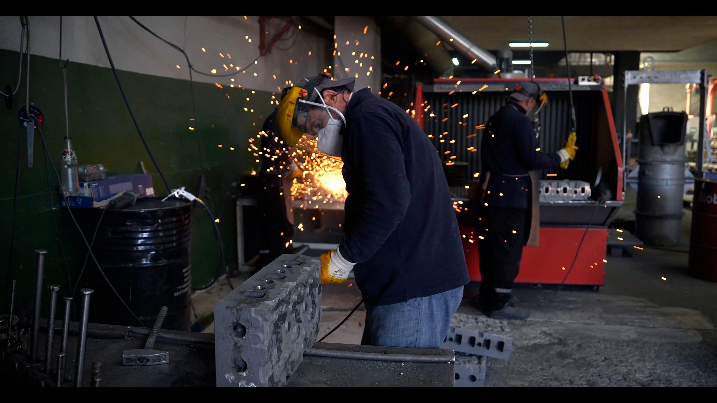
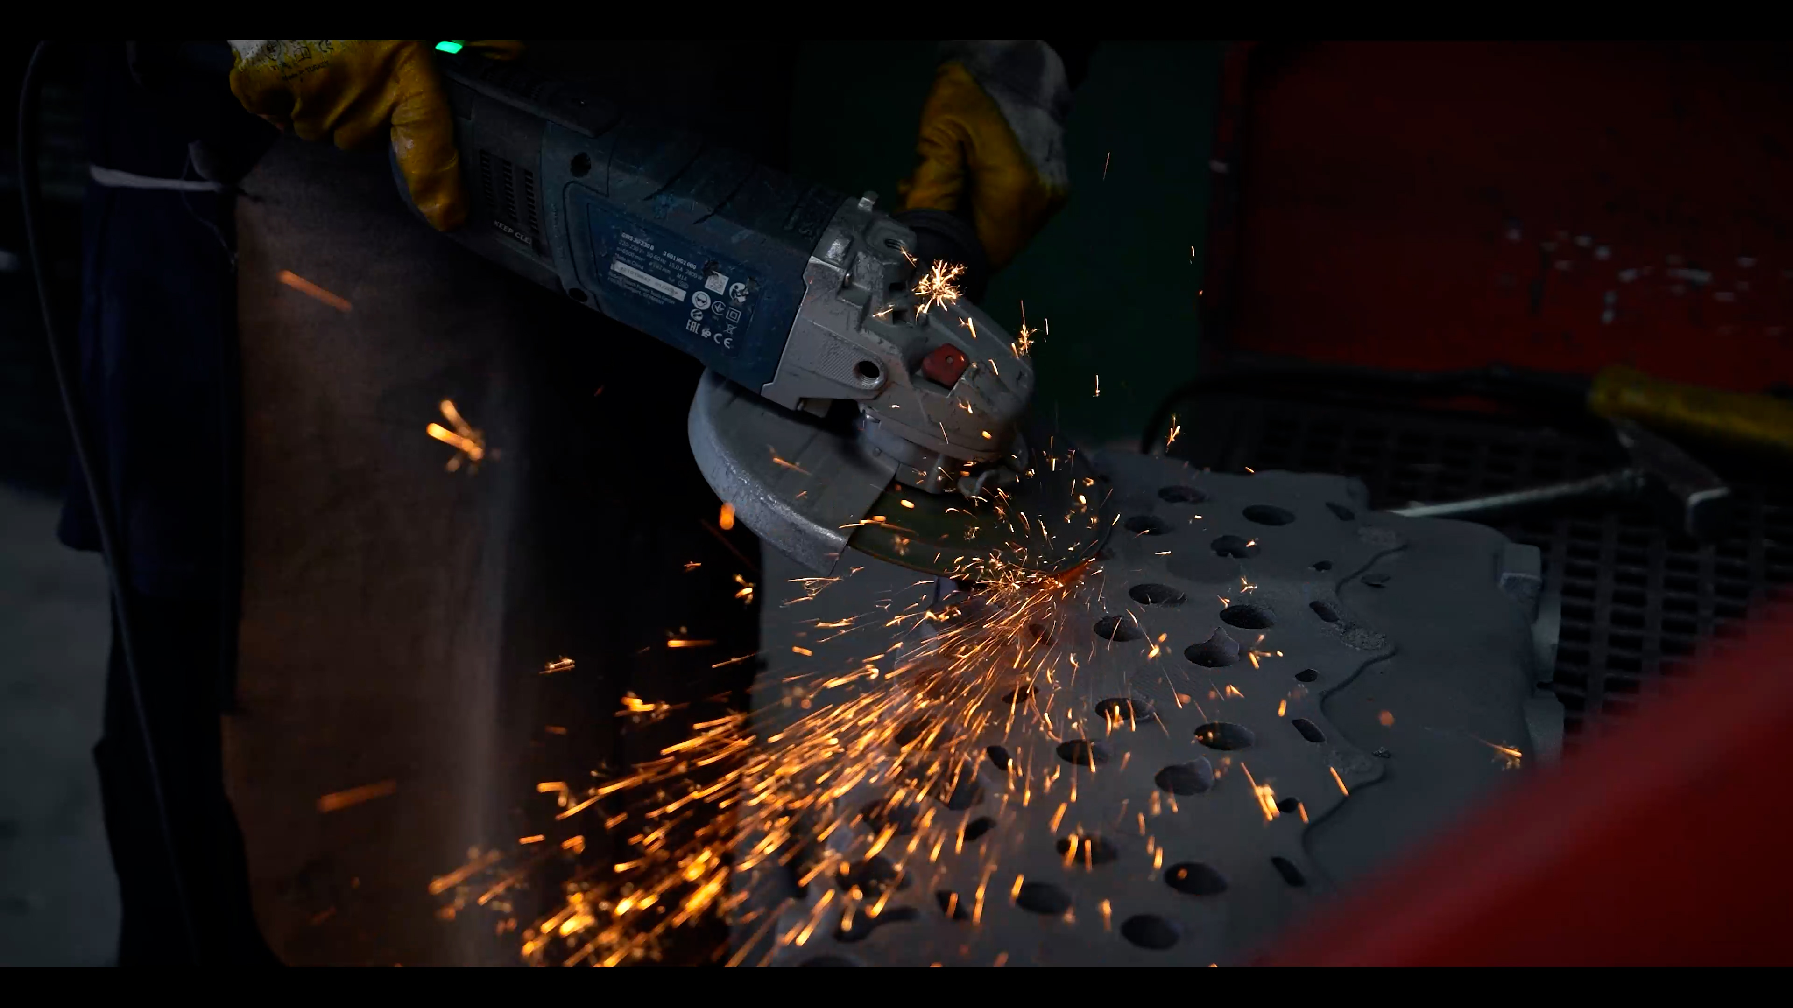
CLEANING and SHOTBLASTING
After the cooling of the sand molds is completed, the sand molds are broken with a shaker and then the runners of the casting parts are cut and removed. The parts are then subjected to grinding and finishing processes (deburring, cleaning, sandblasting).

Slide 15
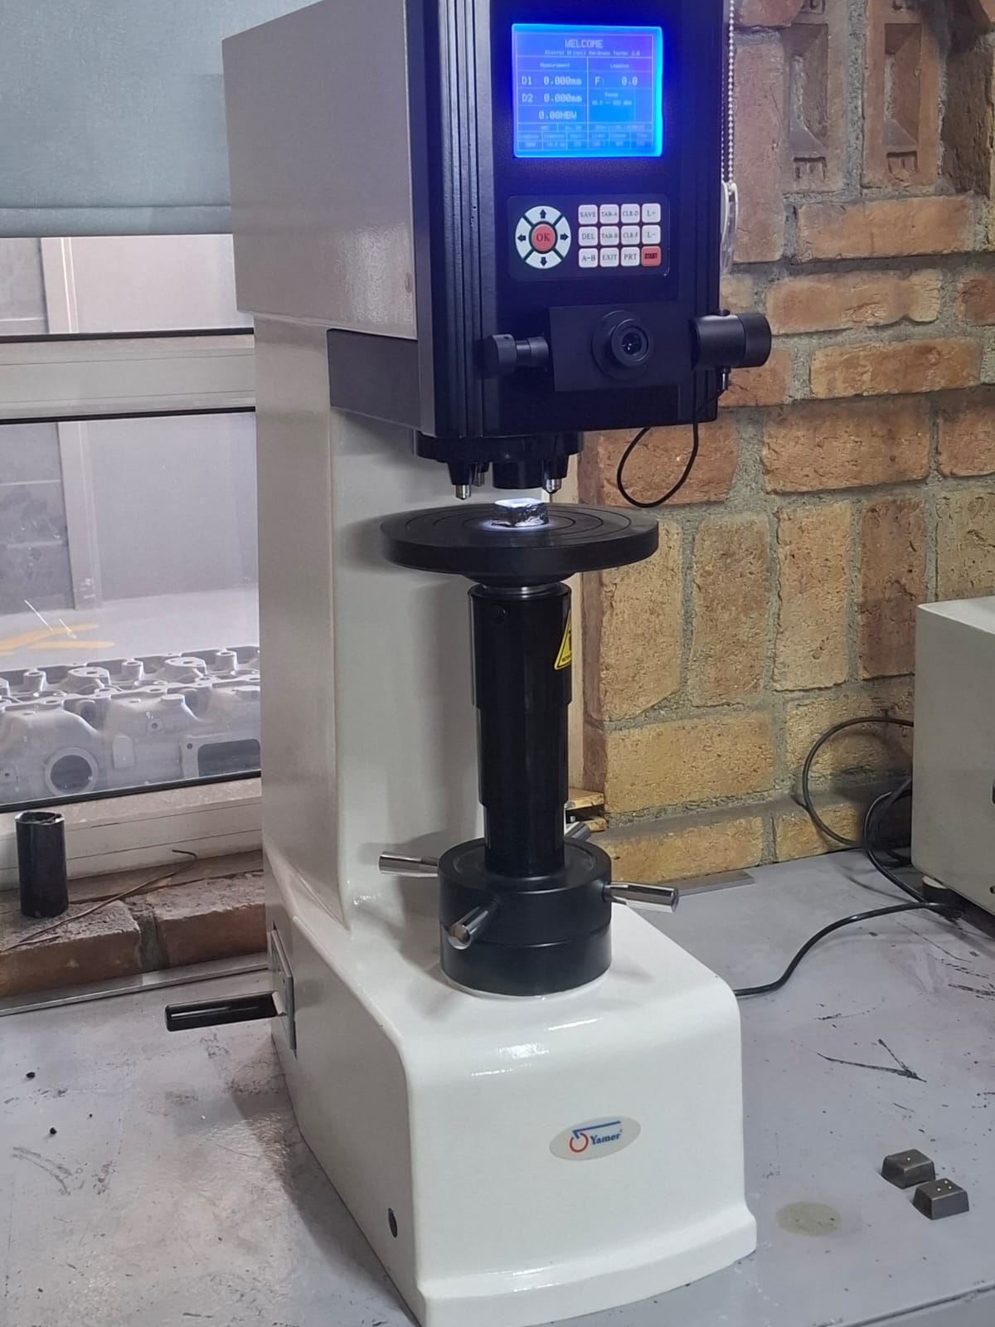
QUALITY CONTROL
In our company, controls are made on consumables and final products.
Controls made on consumables
sand grain size
core and mold strength
sand dust amount
In final products, a sample representing the charge is taken in each casting and chemical analysis, microstructure and hardness controls are made from this sample

Slide 16
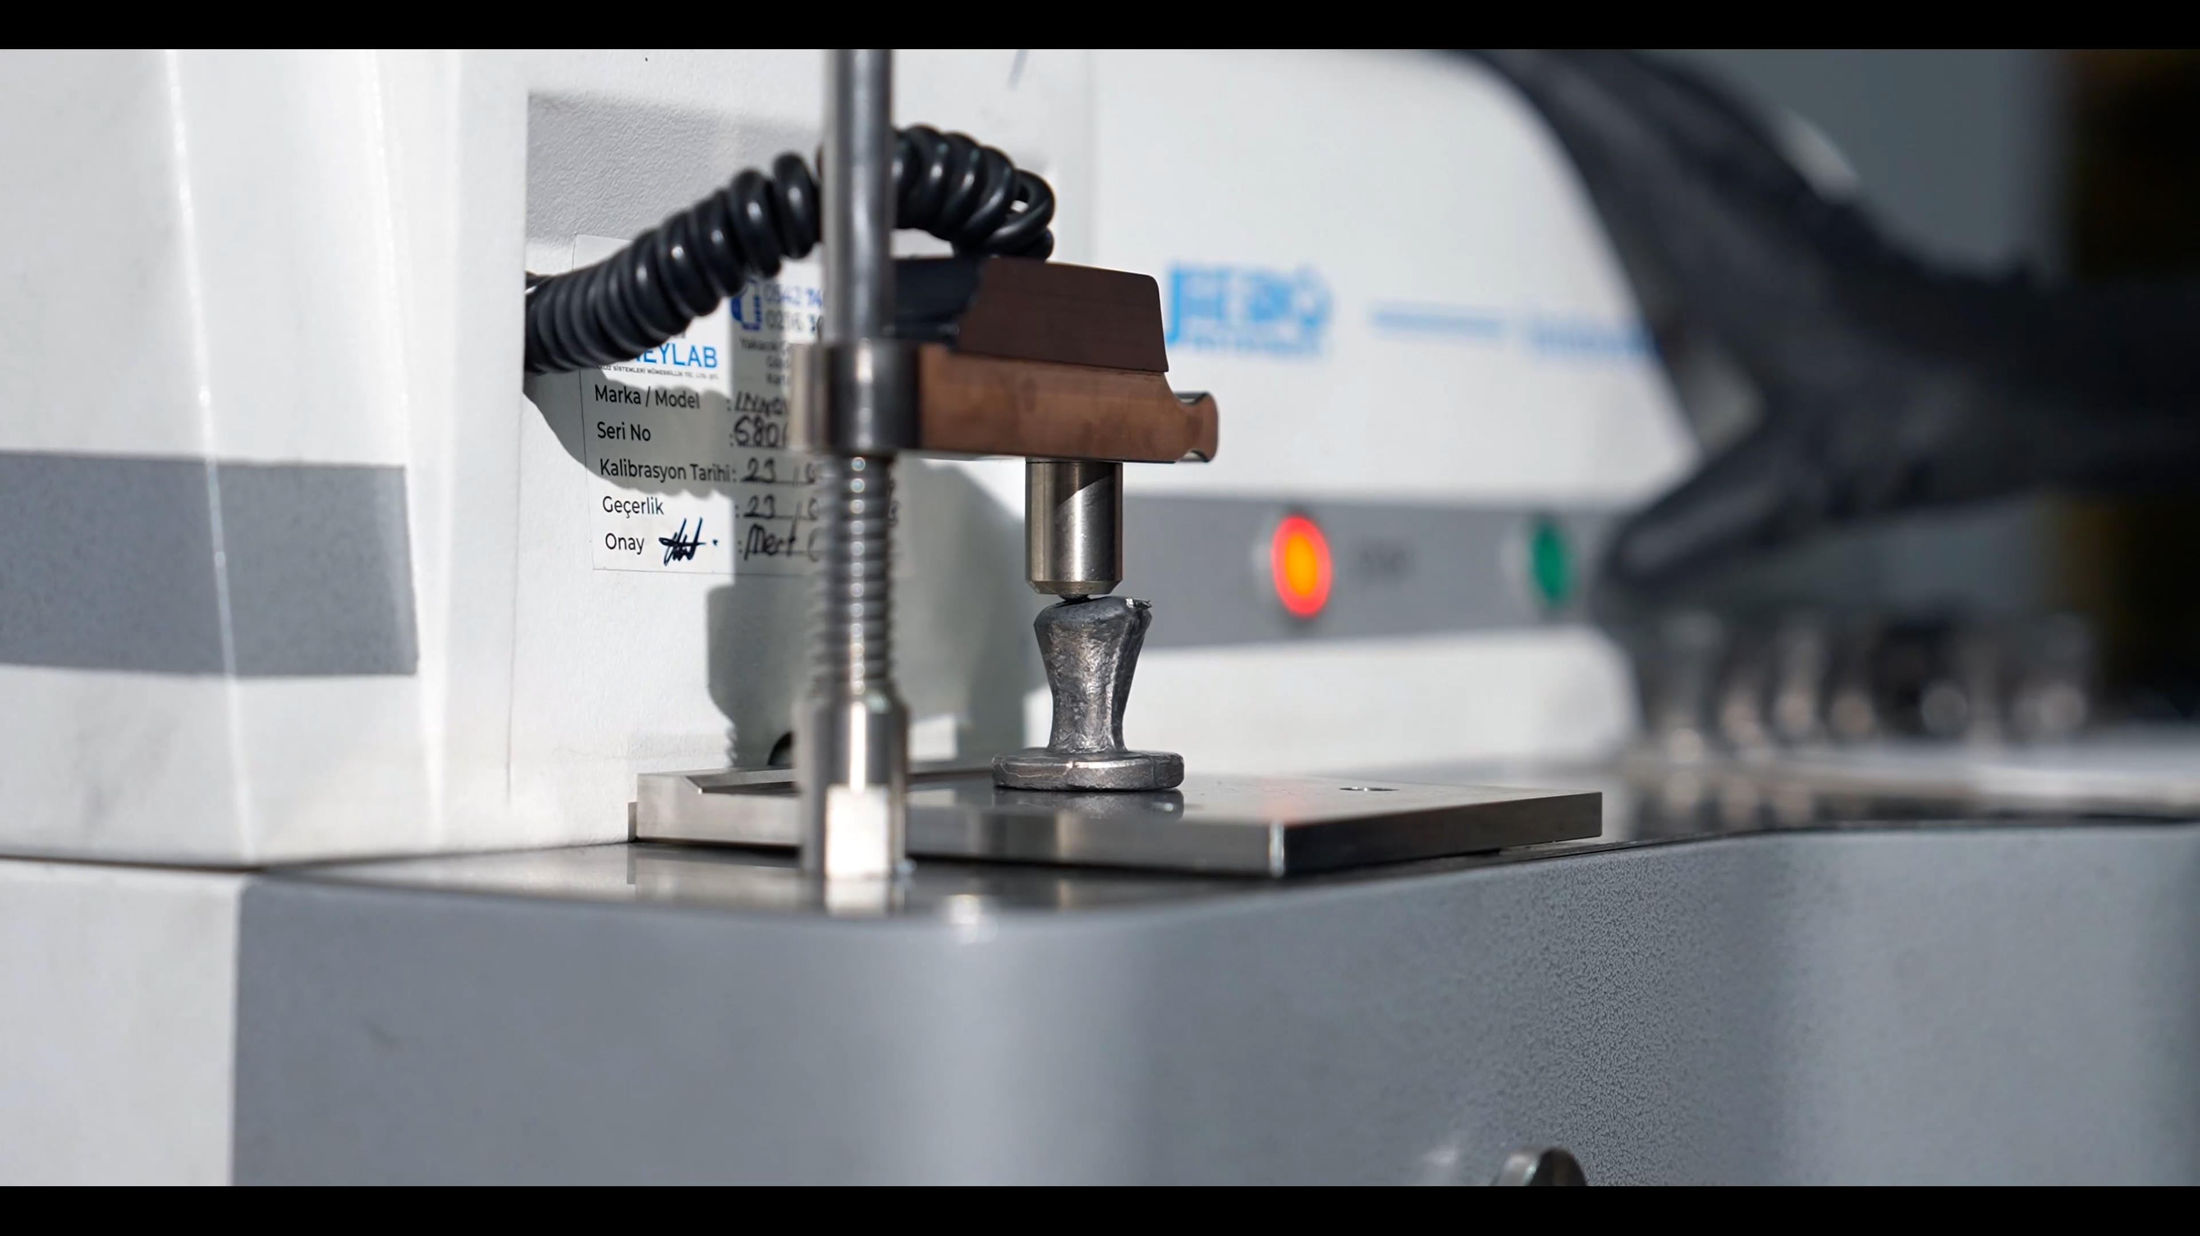
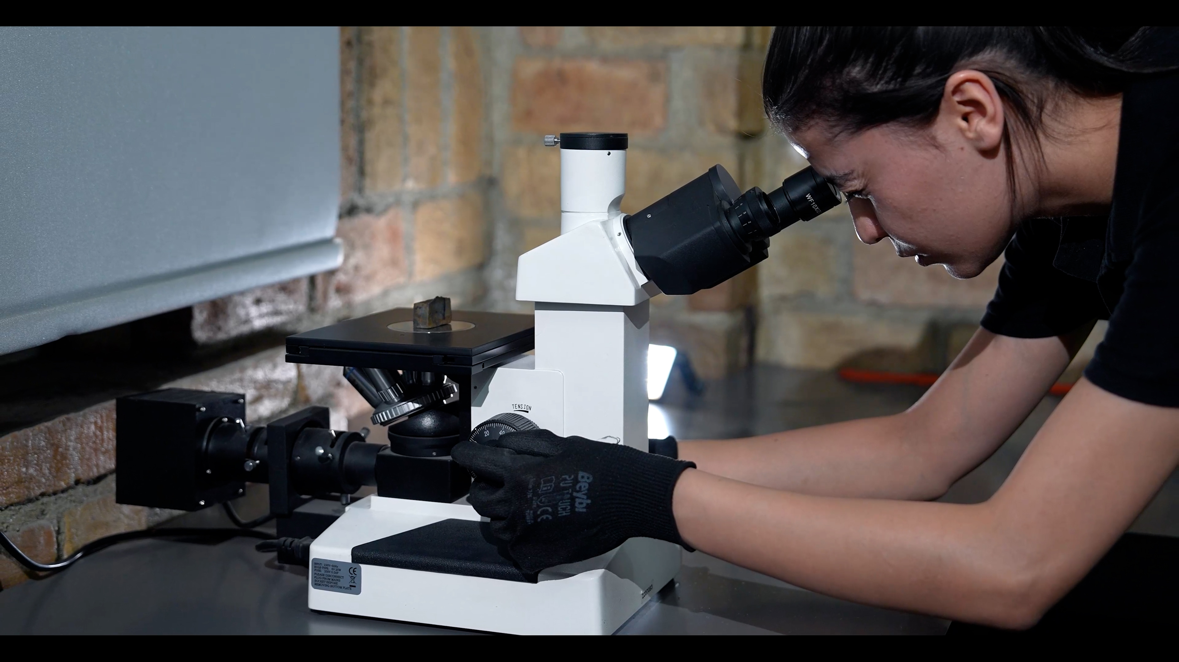
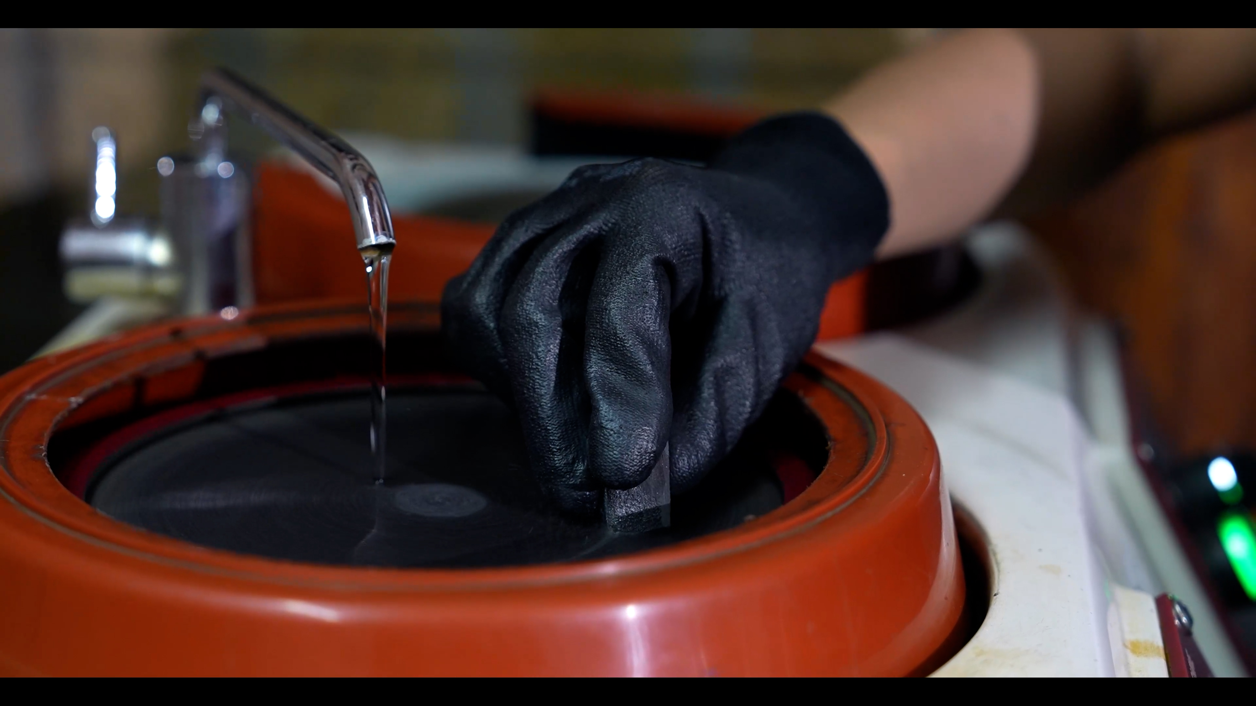
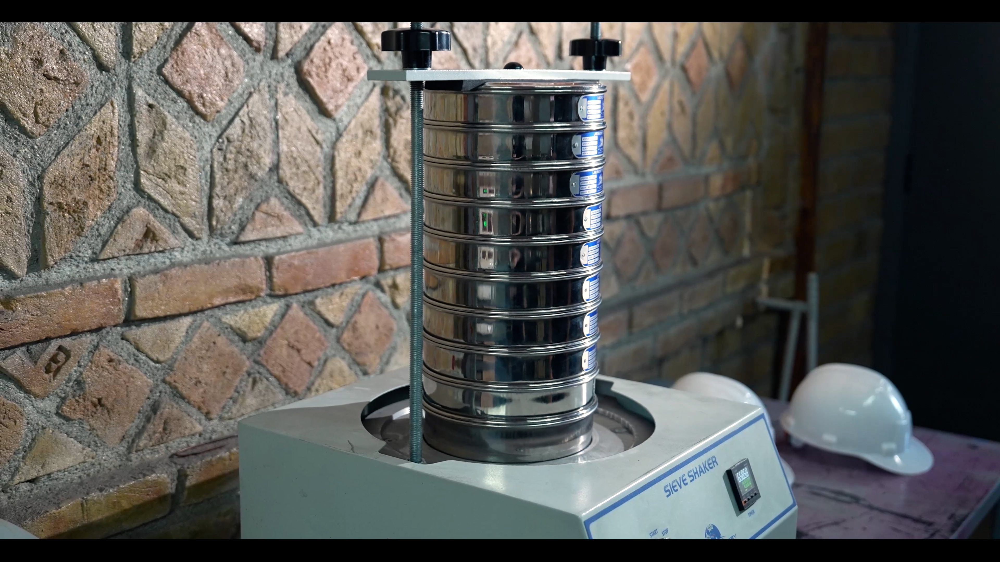

Slide 17
MACHINING
Theprocesssequencein machiningis as follows
Geometric modeling.
Other design applications.
CNC programming.
Process planning.
Tool Design.
-The precise size and geometry of parts are vital when manufacturing prototypes or actual products. Any errors in dimensions can have a significant impact on the entire production process.Because of these we use Coordinate Measuring Machines (CMM)

Slide 18
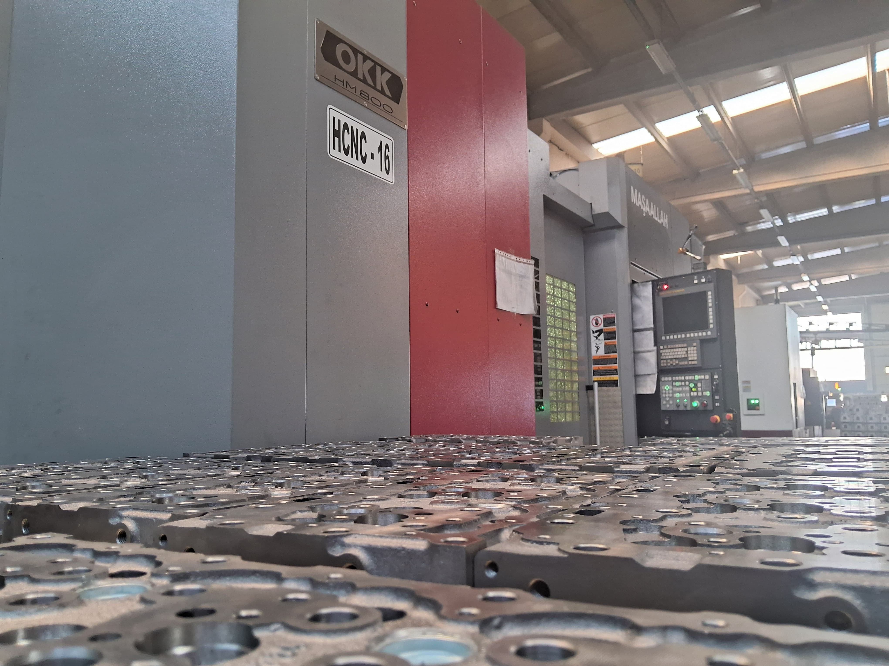
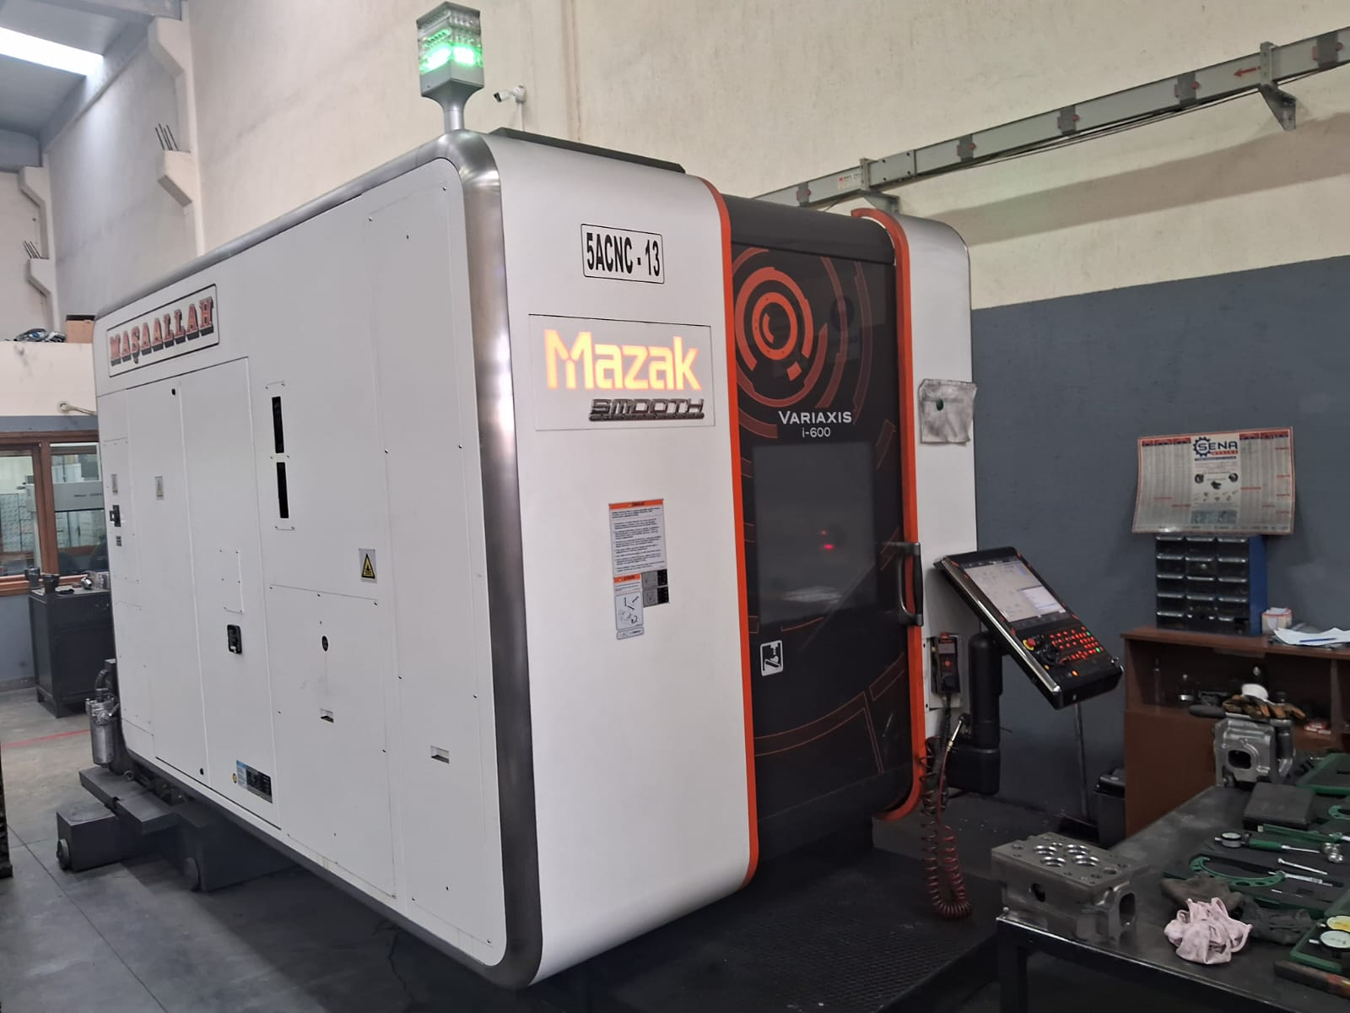
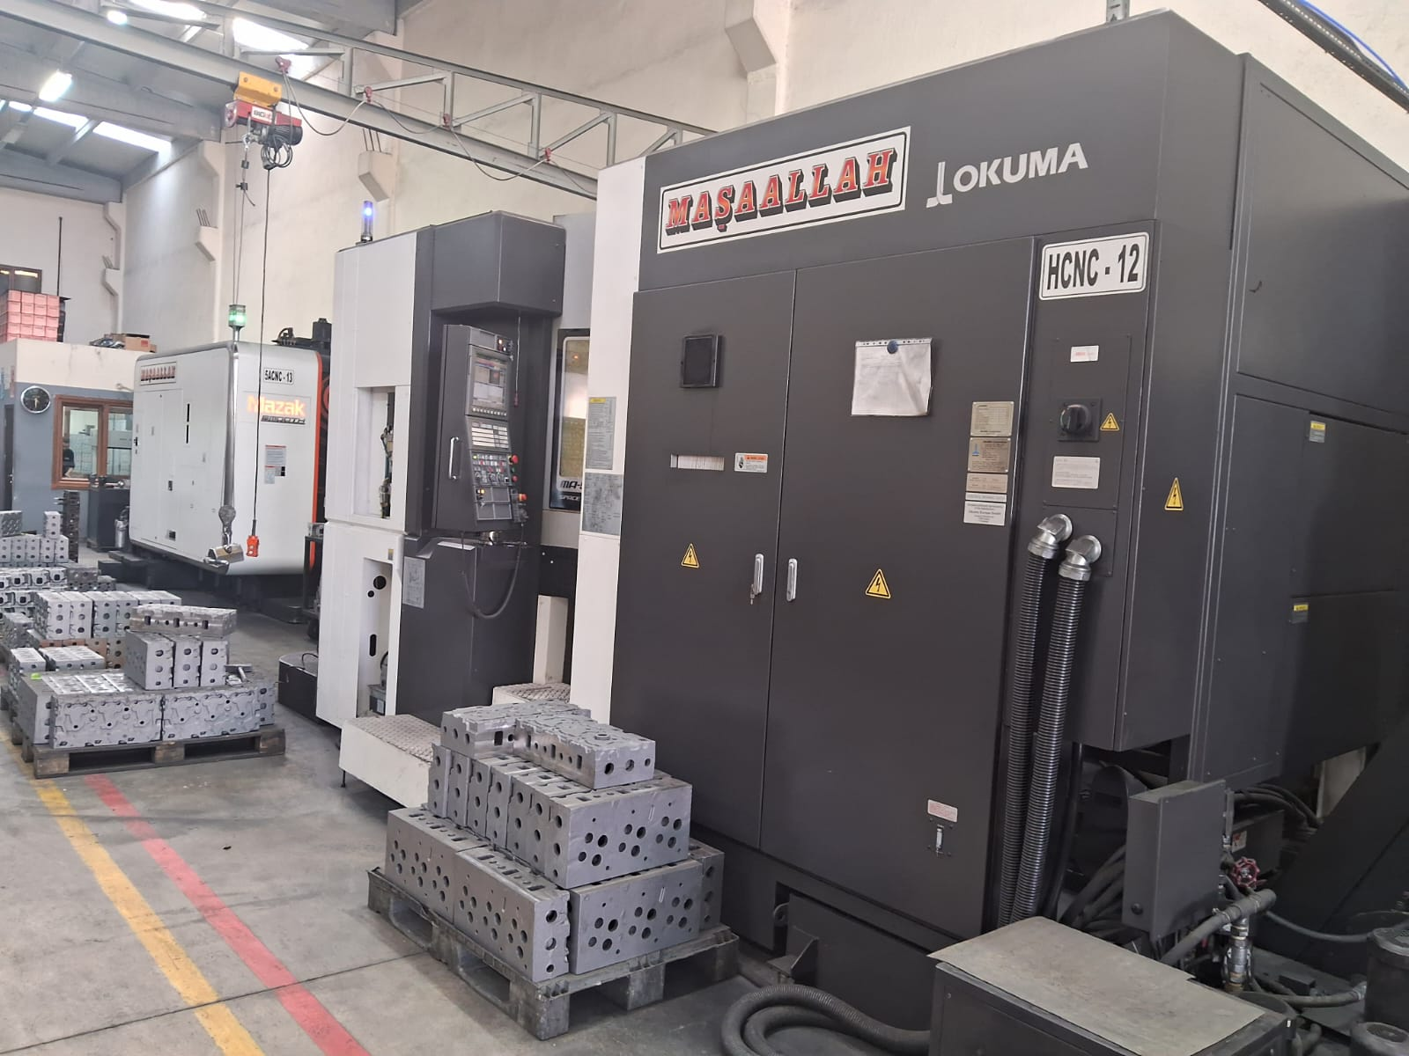
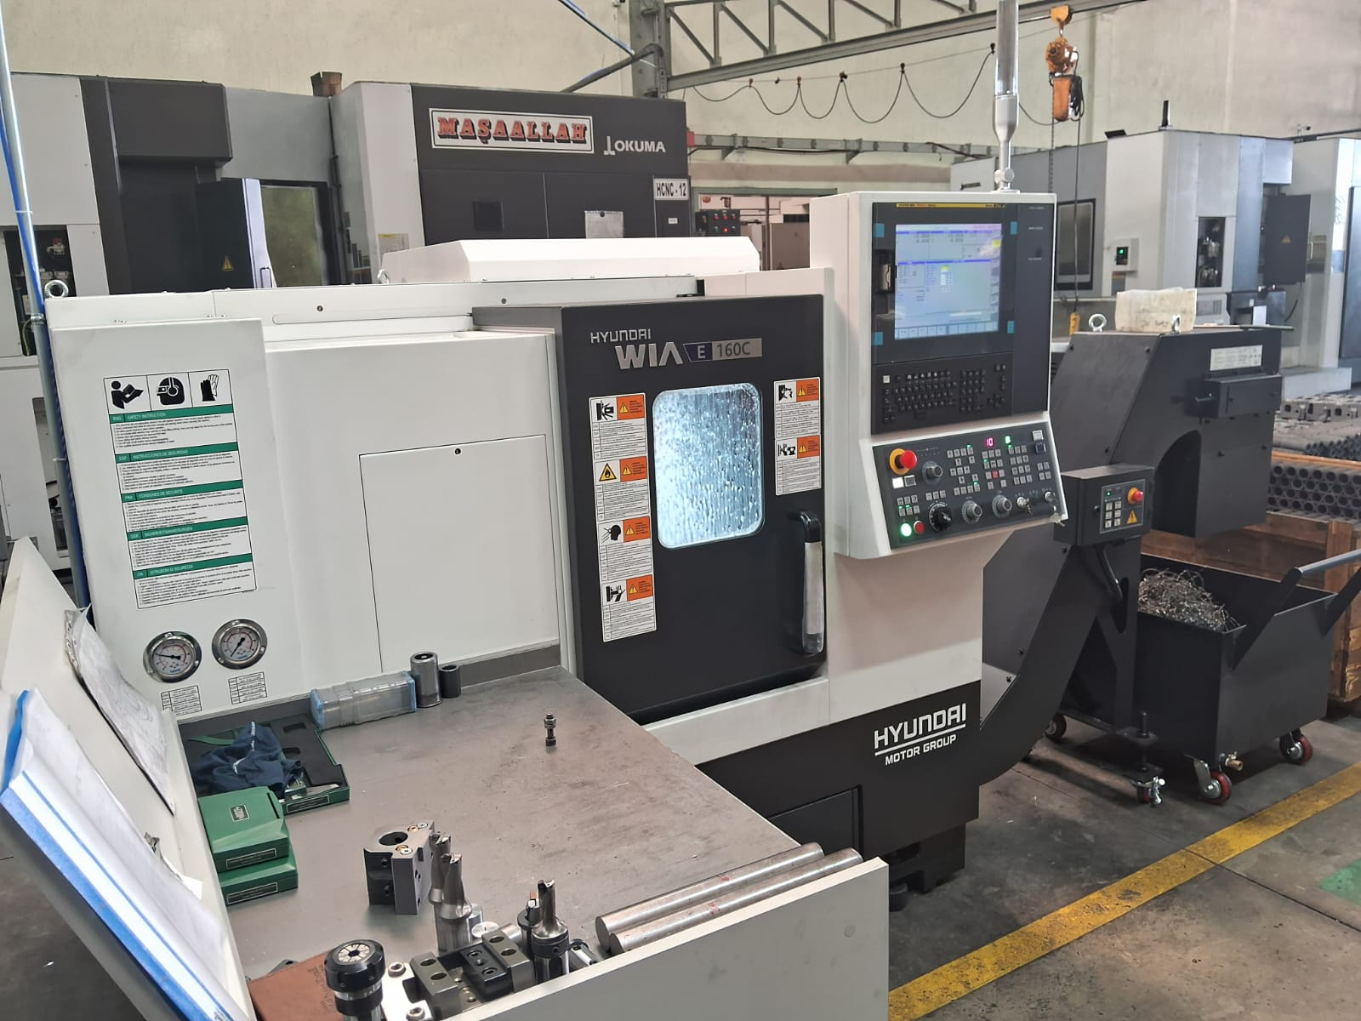
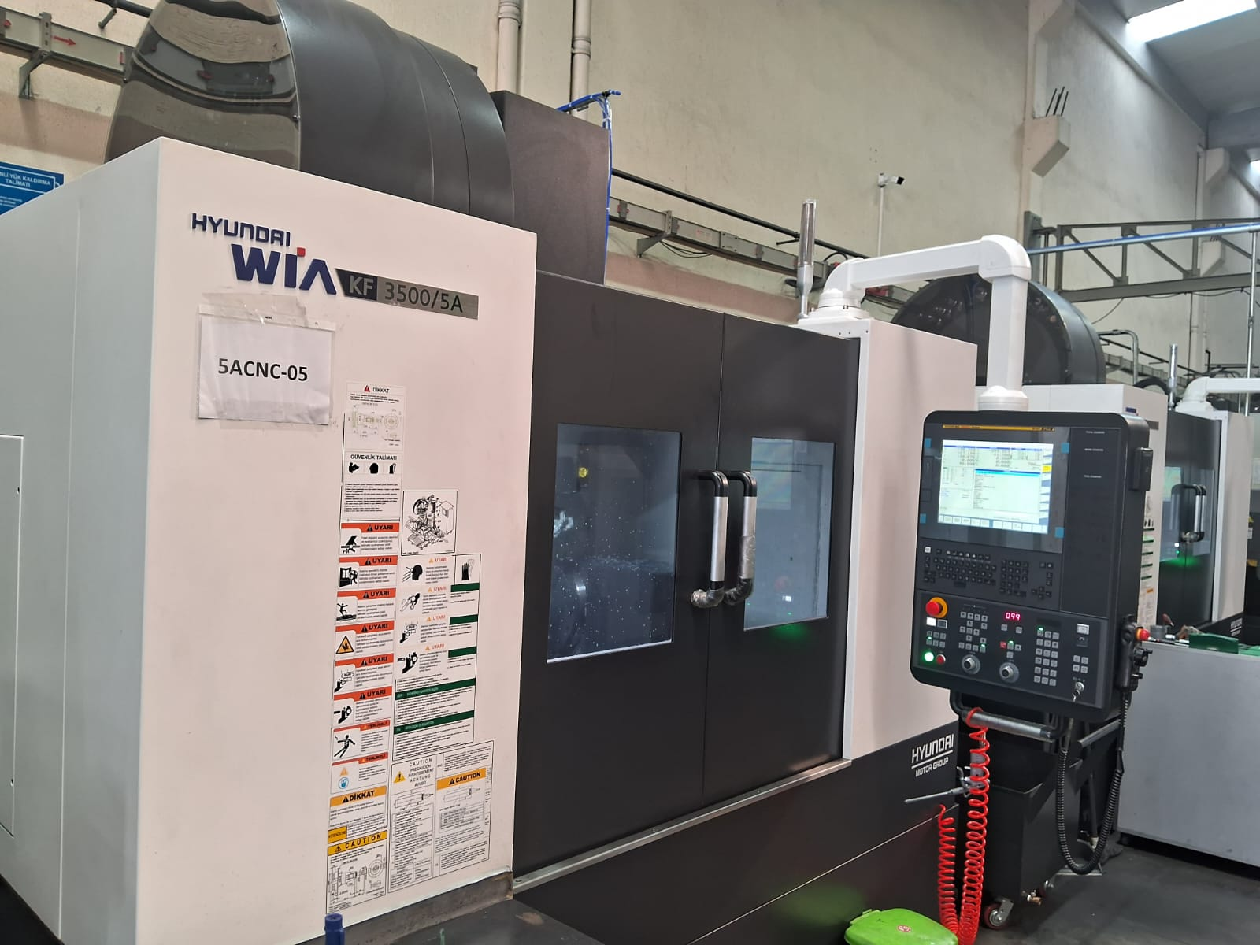
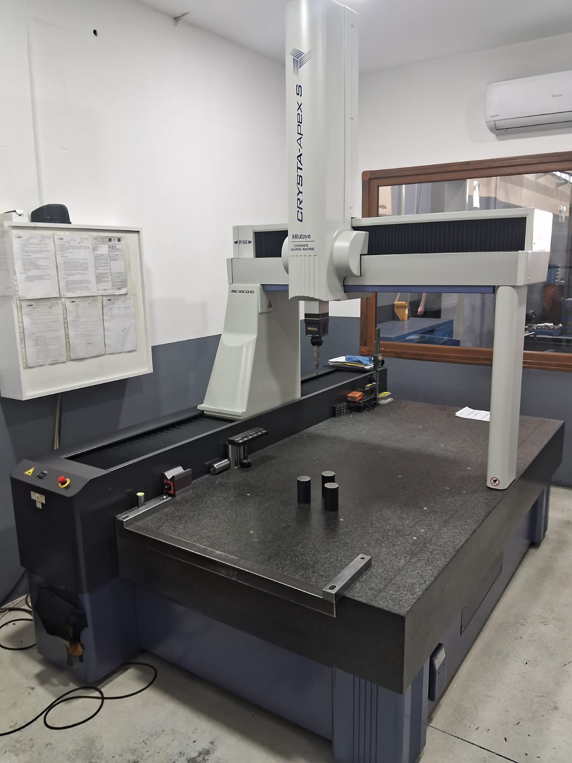

Slide 19
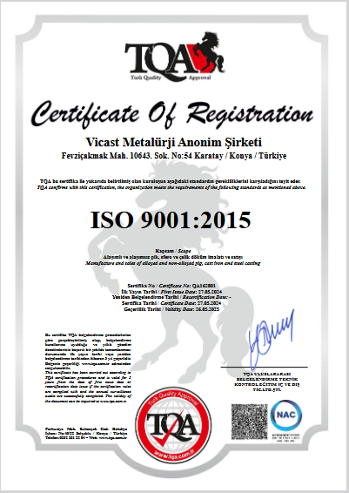
QUALITY ASSURANCE
ISO 9001:2015 Quality Management System is implemented to ensure traceability and follow-up in all units.

Slide 20
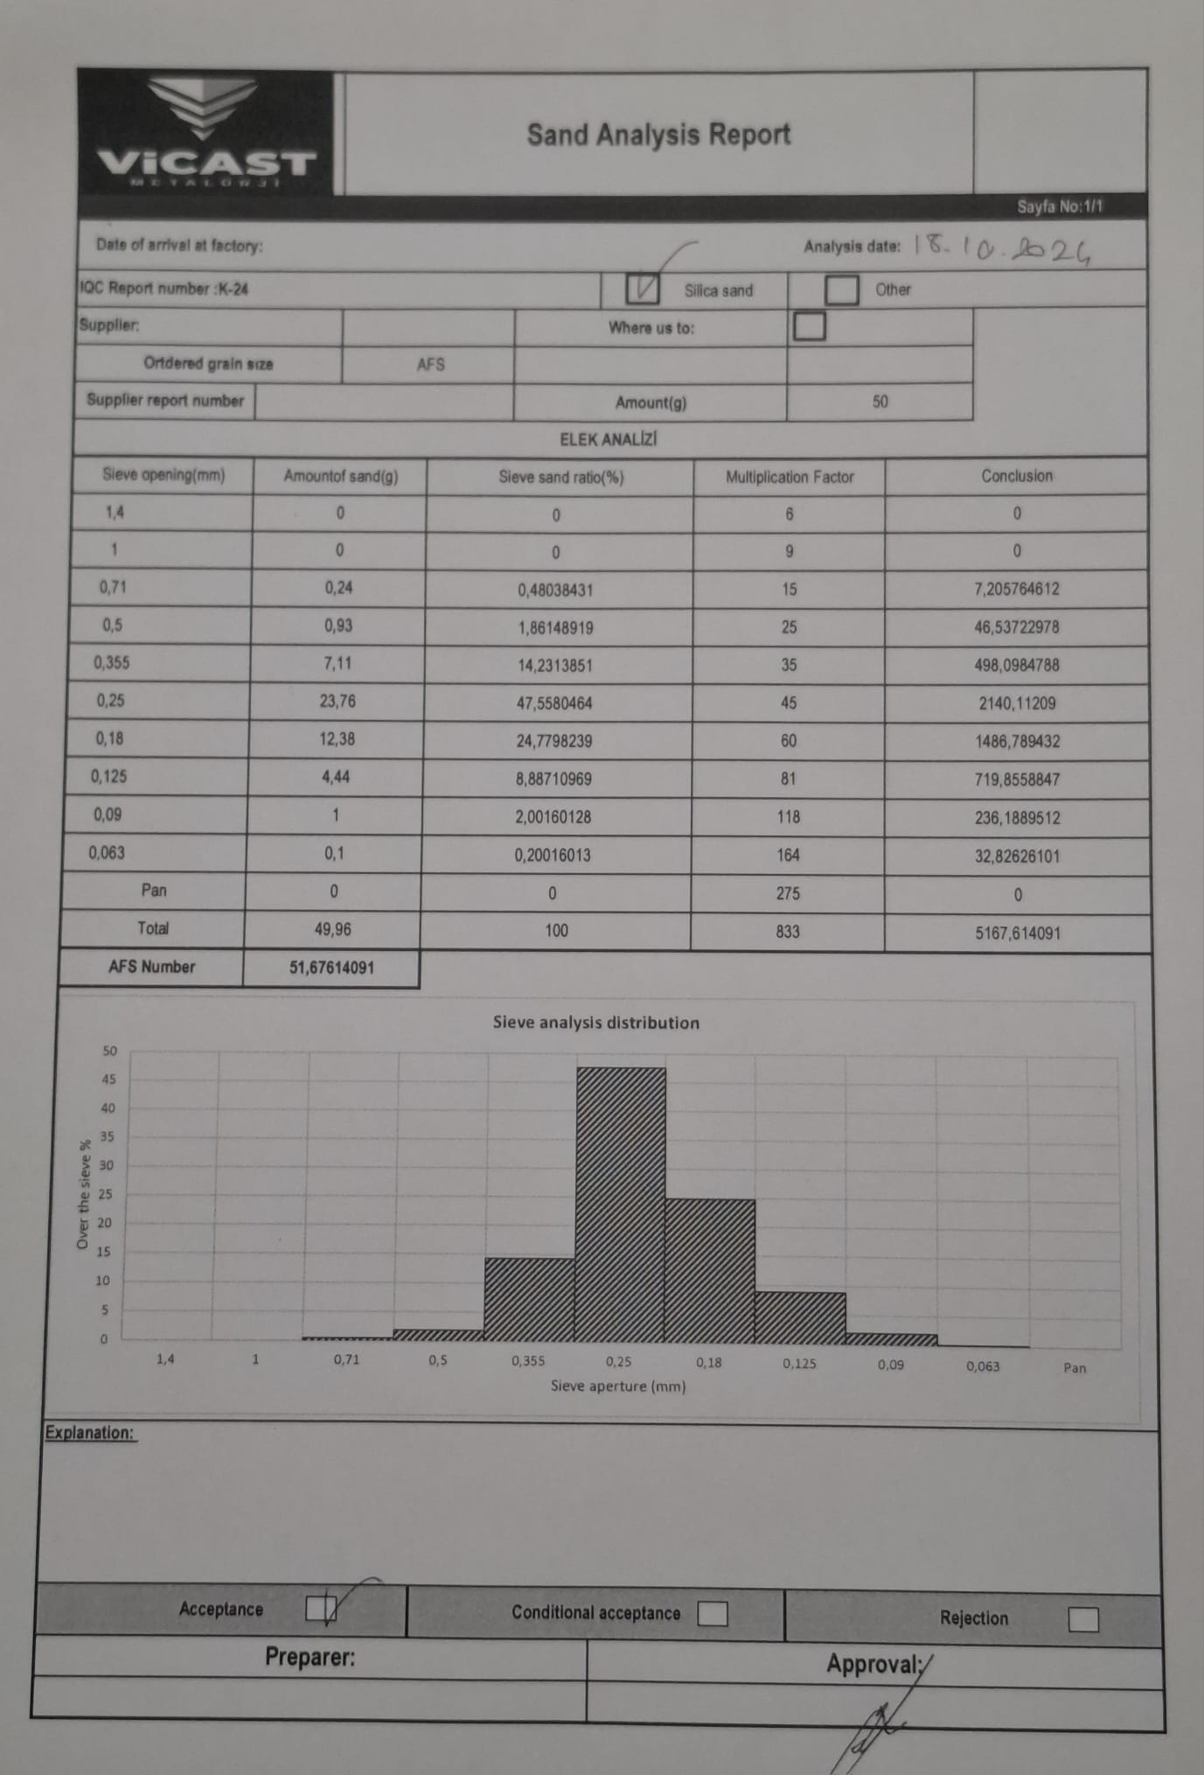
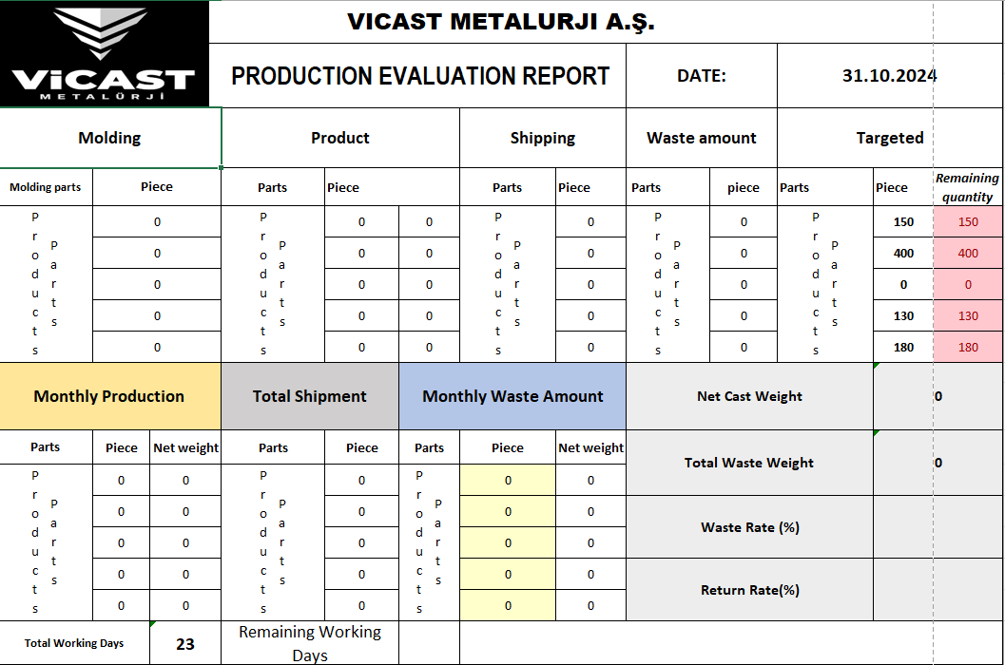

Slide 21
